Slide 1
Powerpoint accessibility
Creating accessible powerpoints from the start

Slide 2
Keys to accessibility
Templates and Themes
Styles
Slide Layouts
Slide Reading Order
Alternative Text for Images
Tables
Links
Other Accessibility Principles

Slide 3
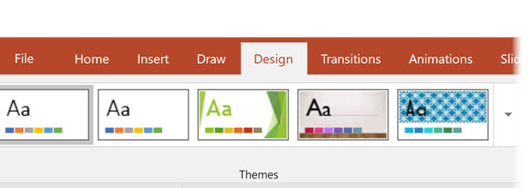
Templates and Themes
Choose themes with good contrast and simple backgrounds
Accessible templates can be downloaded – does not guarantee accessibility but DOES increase likelihood of finding good template
Link: Sampler of Accessible Templates

Slide 4
Styles
General
Headings used correctly to organize presentation content
Do NOT use formatting buttons alone to style text
Fonts
Size: recommend 50+ for headings, 32+ for content
Font style
Headings and bullets: Arial, Calibri, Verdana
Paragraph content: Cambria, Palatino Linotype, Times New Roman

Slide 5
Styles (2)
Colors
Do not use color as the only way to convey information
Use contrasting color (dark on light background, light on dark background)
Avoid color blind combinations (red-green most common)
Spacing
Avoid using Enter to control spacing between points
Change spacing: Home tab > small arrow in the corner of Paragraph group > Spacing box > use After, Before, Line Spacing options
Bullet Points and Lists
Avoid using manually typed characters, such as hyphens or asterisks
Use proper list elements: Home tab > Bullets drop down or Numbering drop down found in the Paragraph group

Slide 6
Slide Layouts
Importance: Ensures the information on slides has the correct heading structure to allow navigation and proper reading order by a non-sighted user
How does a screen reader navigate?
Typical layout components
Slide “title” is presented as a heading to screen reader users
Ensuring it is read first on each slide allowing navigation
One or more “placeholder” areas where content (lists, images, tables) is entered

Slide 7
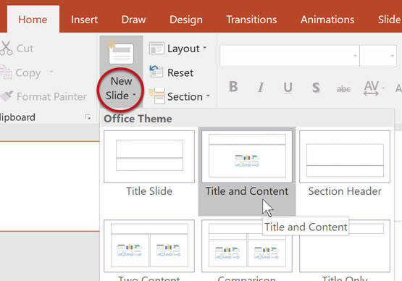
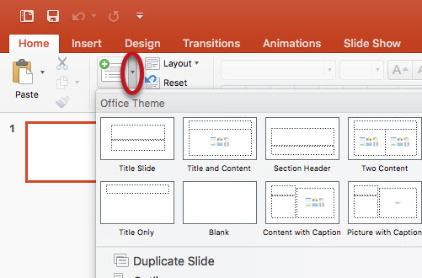
Slide Layout: new slide
How to create a new slide:
Home or Insert tab > choose New Slide icon > PowerPoint will usually create a new slide with the same layout as the currently-selected slide
To select a specific layout while creating a new slide:
Select the small arrow next to the text “New Slide” on the icon > drop down menu will be shown and you can choose a layout

Slide 8
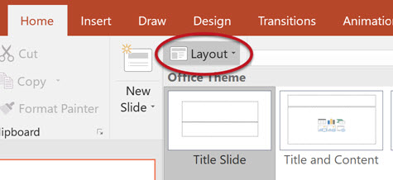
Slide Layout: existing slide
How to change slide layout on an existing slide:
Select the slide you would like to change.
On the Home tab, select Layout.
Choose the desired layout from the dropdown.

Slide 9
Slide master
Use: Provides ability to make changes to all slides within a presentation (changing text size of all slide titles, changes to specific slide layout, create new custom layouts)
How to set up slide master:
Select View tab > Slide Master
The first slide in the left hand sidebar is the Master Layout which will apply all changes to this layout to every slide in the presentation
Changes to slides under the Master Layout will be applied to only slides that use that specific layout

Slide 10
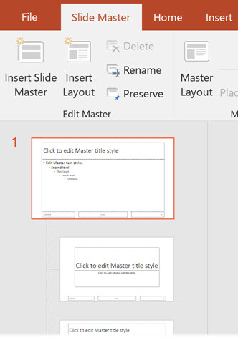
Slide master (2)
To create new slide layout:
Select Insert Layout > Rename to give new layout a descriptive name > then you can: insert placeholder objects, change size and position of objects on the slide, etc.
Save changes to the layout:
Select Close Master View (or Close Master on Mac). All changes will automatically be applied throughout the presentation

Slide 11
Slide reading order
Importance: Ensures everyone reads the content in the order you intended
How does a screen reader generally navigate reading order:
Usually read in the order defined by the slide layout
#1: Slide title
#2: Prepopulated content areas that would contain lists, images, tables
#3: Additional content is read in the order in which it was added to the slide

Slide 12
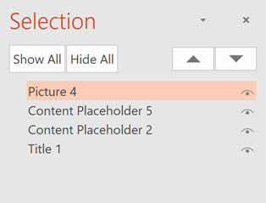
Slide reading order (2)
How to check/change the reading order
Home > Arrange > Selection Pane
Reading order for the elements are listed bottom to top (bottom is read 1st by the screen reader)
To reorder: click and drag into the appropriate position

Slide 13
Alternative text for images
Importance: Helps people who can’t see the screen to understand what’s important in images and other visuals
Other visuals: pictures, SmartArt graphics, shapes, groups, charts, embedded objects, video
Avoid using text in images as the sole method of conveying important information

Slide 14
Alternative text for images
What does a screen reader do with an image?
If no alternative text is available, the screen reader will either:
a) reference “Image” and move on or
b) make no reference that an image is present

Slide 15
Alternative text (2)
How to Add Alt Text In PowerPoint 365 and 2019
Right-click on the image > select Edit Alt text > enter appropriate alternative text in the Alt Text sidebar field
If the image is decorative, leave the field blank and check Mark as decorative.
NOTE: Do not select the "Generate a description for me" button (Windows-only). The quality of the automatically-generated descriptions is usually very poor, and a description of an image is often not the same as alternative text.

Slide 16
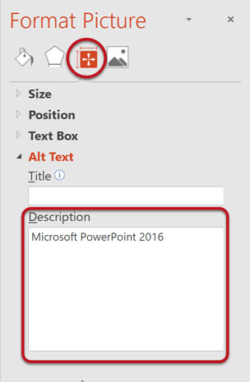
Alternative text (3)
How to Add Alt Text PowerPoint 2016
Right-click on the image > choose Format Picture > select the Size & Properties icon (3rd image to the right) > choose Alt Text.
Enter appropriate alternative text in the Description field only (not the Title field).

Slide 17
tables
Importance: Provide information about how one piece or sets of information relates to another and is a quick tool to recognize data patterns and relationships
How does a screen reader access a table:
Without proper formatting: read in literal order as the table code; linear reading order that may not be the same as visual reading order
With proper table reading format: reads the content in the visual reading order to put meaning on the information
Provides location reference for content being read without having to listen to the entire table:
Label column headers: column headers are read as the user moves horizontally along a row; allows user to review the title of the column without navigating back up to the first row to remember which column they are on
Label row headers: row headers are read s the user moves vertically up and down a column
Example: Screen reader reading different table layouts

Slide 18
Tables (2)
Steps to identify column headers in a table:
Click inside the table > Table Tools options should become visible > Design tab (called Table Design on Mac) should be opened
If the top row of the table contains headers for each column (most tables do), make sure the Header Row checkbox is selected.
Steps to identify row headers in a table:
If the first column of the table contains headers for each row, make sure the First Column checkbox is selected.

Slide 19
Tables (3)
Avoid merging cells: blocks screen reader from navigating in a way that makes sense, increasing likelihood of content confusion
Avoid nesting tables inside of tables: increases likelihood screen read will have problems navigating and getting stuck inside a cell
Deep Tendon Reflex | Side |  | Finding
 | Left | Right | Negative | Positive
Patella
Medial Hamstring
Achilles

Slide 20
TaBLE 1.3: human body regions
Region Name | Description
Abdominal | Region inferior to the thorax and superior to the pelvic brim of the hip bones
Antebrachial | Forearm (the portion of the upper limb between the elbow and the wrist)
Antecubital | Region anterior to the elbow; also known as the cubital region

Slide 21
Links
Inserted URLs are automatically created as hyperlinks but screen readers will read the entire URL address which will not provide much useful information to the screen reader user
Rather add descriptive text to be displayed and read in lieu of the URL address
Hyperlink text: https://xess7-prod.ec.jccc.edu/StudentRegistrationSsb/ssb/term/termSelection?mode=search
Description: JCCC Credit Class Search

Slide 22
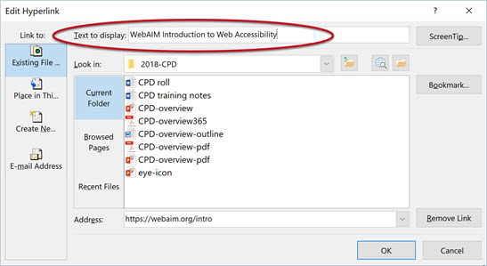
Links
Steps to change the displayed text of the hyperlink
Right-click the link > select Edit Hyperlink (on Mac, right-click the link and select Hyperlink > Edit Hyperlink) > in the dialog box click in the Text to Display field at the top > enter descriptive text for the link

Slide 23
Other accessibility principles
Transitions and animations should be simple.
Can be distracting
Flashing or highly visual transitions/animations can cause vestibular disturbances and/or trigger seizure disorders
Video: Ensure it is captioned
Transcript: Ensure a transcript is available in lieu of any embedded audio

Slide 24
Check accessibility tool
Tool to assist in identifying many common accessibility issues
Results of running the tool to inspect the presentation will be listed in 3 different categories:
Errors: Content that makes the document difficult or impossible to read and understand for people with disabilities
Warnings: Content that in most (but not all) cases makes the document difficult to understand for people with disabilities
Tips: Content that people with disabilities can understand but that could be presented in a different way to improve the user’s experience

Slide 25
Check accessibility tool (2)
Selecting an item in the report will provide information about the issue and instructions on how to repair it at the bottom of the sidebar

Slide 26
references
Microsoft PowerPoint: Making presentations accessible to people with disabilities
WebAIM: PowerPoint Accessiblity

