Slide 1
Ignite and Play – Thinking in a Gaming Habit of Mind or WPA Framework: The Video Game!
Maureen Fitzpatrick
Johnson County Community College
mfitzpat@jccc.edu
Notes:
Objective to

Slide 2
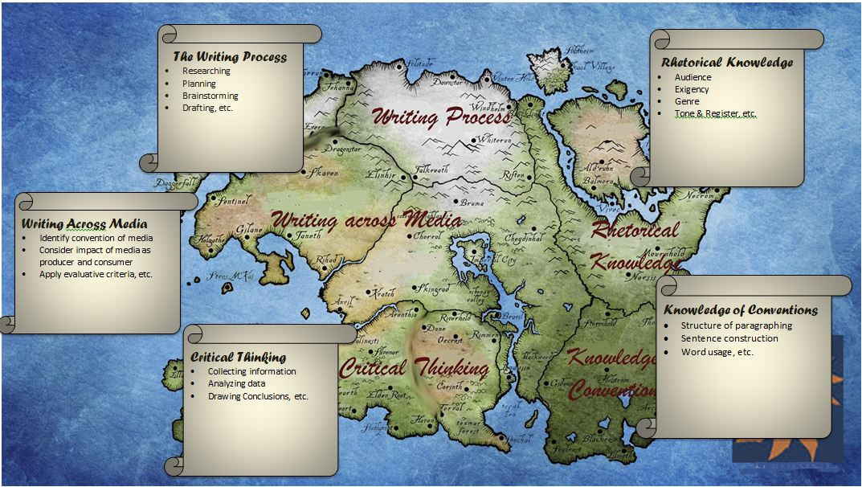
The Gameworld for FrameworkGamified

Slide 3
Welcome to Participatory Culture
2009 report Confronting the Challenges of Participatory Culture, Henry Jenkins notes
At that time already nearly 60% of teens are producers as well as consumers of participatory media, which includes the creation of web pages, blogs, YouTube videos, etc.
Forward 4 years and throw in Facebook, Twitter, Vine, Instagram and Yik Yak, the numbers go higher.
Notes:
So our students are living in participatory culture, but often with no guidance about the potential power the have at their fingertips

Slide 4
What is Participatory Culture?
Low barriers to artistic expression and civic engagement
Strong support for creating and sharing creations
Informal mentorship whereby experienced participants pass along knowledge to novices.
A belief that contributions matter and some degree of social connection.
--Jenkins
Notes:
Low barriers to participate, support for creating, mentorship of experienced, & believe their contributions matter
In other words—it has the same goals as a composition class.

Slide 5
Benefits of a Participatory Culture
Opportunities for peer-to-peer learning
Changed attitude toward intellectual property
Diversification of cultural expression
Development of digital and communication skills valued in higher education and the workplace
A more empowered conception of citizenship

Slide 6
The New Digital/Participatory Divide
Jenkins notes a new digital divide based not solely on income, that the divide comes less in technology and more in the social skills. He defines three new gaps:
Participation gap – unequal access to opportunities and experiences that encourage experimentation.

Slide 7
New Digital/Participatory Divide
Transparency problem– the need to be taught, as both consumers and creators, to recognize the way media shapes perceptions

Slide 8
New Digital/Participatory Divide
The ethics challenge—the breakdown of traditional ways of preparing people to engage in public discourse through their role as media makers.
Educators must envision ourselves as mentors in participatory culture, which for most of us means getting out of our process-era boxes.

Slide 9
Play: a new Skill for the Age of Participatory Culture
Jenkins lists 12 (on handout)
Play: “Capacity to experiment with the surroundings as a form of problem solving”

Slide 10
James Paul Gee
‘‘A game is nothing but a set of problems to solve’’
Notions of learning—Classroom v. Games
Short attention v. Long attention spans
“Chunking”/Scaffolding v. Complexity
Bubble-wrapped curriculum v. Learning from failure

Slide 11
McGonigal’s Definition of Game
Games are goal-driven
Games contain feedback systems
Games operate under a rules
Participation in games is voluntary.

Slide 12
The Problem with Educational Gamification
Designers focus more on the goal than the game.

Slide 13
Warren Spector’s RPG Commandments
Each player's path through the story must be unique.
Players must always have clear goals.
The level of interactivity must be high,
The central character must grow and change in ways that matter to players in an obvious and personal way.
The game must be about something more than killing things, solving puzzles, and maxing out a character's statistics.

Slide 14
How is Game Design Different than Assignment Design?
This exercise is about
Creating a world that encourages exploration.
De-emphasizing linear process
Making failure—particularly spectacular failure—part of the learning process
Cultivating habits of learning

Slide 15
Challenge: Contribute to the Hypothetic Video Game FRAMEWORK GAMIFIED
Three elements our designs have to have:
A Landscape—a location or gameworld where we can send students to explore, interact, experiment and fail.
Quests – tasks to be completed by traversing the gameworld and practicing their skills to accomplish small and large goals
Weapons, Abilities & Skills– talents they can develop, hone, and use collaboratively to solve the problems we give them.
Notes:
For the next 7 minutes, I’m asking you to Contribute to a Hypothetic

Slide 16
Criteria for Habit Badges
Measurable
Submit work
Quiz scores
Project completions
Approvals from professors, librarians, partners, tutors, etc.
Goals across assignments or even courses
Must encourage autonomy—sandbox play not path-driven

Slide 17
Sample—The Persistence Badge
Complete all first drafts by target dates
No more than 3 absences
Revise all papers
Revise your weakest paper multiple times
Ask a question at least once a week
Be prepared for peer review
Stick with the original topic you pick for the research paper
Respond to peer review letters
Survey people about your paper topics for multiple points of view. Research all of them.
Locate logos, pathos and ethos type evidence for all major points

Slide 18
Set Criteria for A Habits of Mind Badge
Select one of the habits of mind and create a list of 8-10 tasks or challenges that must be completed over the course of the semester to earn this badge.
Curiosity
Openness
Engagement
Creativity
Persistence
Responsibility
Flexibility
Metacognition

Slide 19
worktime

Slide 20
Badge Movement
Badges are microcredentials used to certify skills and abilities not recognized by traditional institutions and employers
Purdue Passport
http://www.itap.purdue.edu/studio/passport/
To learn, build and play
Mozilla Open Badge http://openbadges.org/
With Blackboard https://badges.coursesites.com/
Look for them on Facebook, et. al.
Credly: https://credly.com/

Slide 21
Questions?
Post your badge criteria or quest specifications to
https://sites.google.com/a/stumail.jccc.edu/frameworkgamified/

