Slide 1
Just to think about . . .
Imagine you are shooting a scene where the point-of-view character is a police officer whose partner has just been shot. What camera angles you would use to shoot the scene immediately following the gunshot and partner collapsing to the pavement? Explain why you would select those angles/transitions.
Imagine you are shooting a scene where you are introducing the antagonist for the first time--the antagonist will walk into a crowded room where your protagonist is already sitting. What do we hear? Is there anything we don’t hear?
Imagine you are shooting a scene where your math genius protagonist is solving a complex problem over a series of hours. Describes the series of images we will see to indicate the elapsed time. What do we hear?

Slide 2
Digital Storytelling
Maureen Fitzpatrick

Slide 3
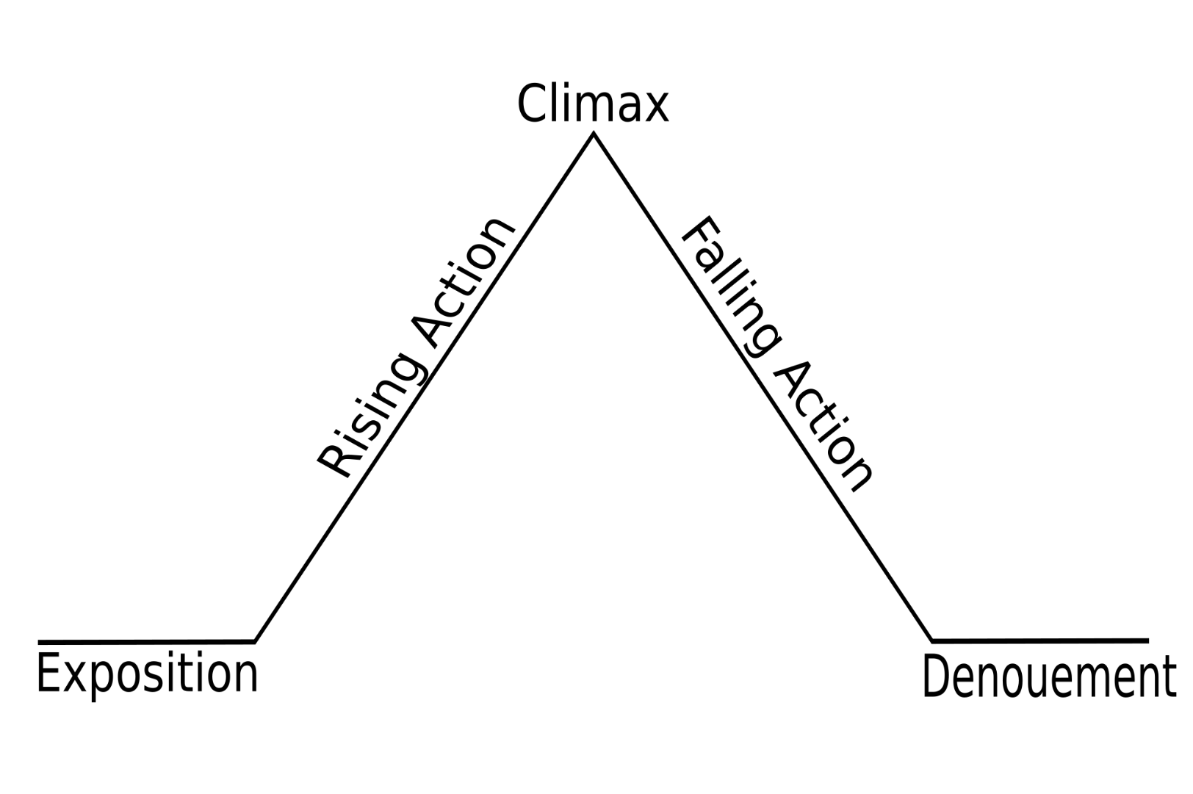
How can a story be an academic genre?
Traditional definition of story:
“Content presented in a sequential manner”
Beginning, middle & end
Story is hard wired into the brain

Slide 4
The importance of a meaning
Not a story:
The queen died and then the king died.
A story:
The queen died, and then the king died of a broken heart.

Slide 5
Are these stories?
Balance sheet?
An hour waiting in a place?
A clinical description of a medical procedure?

Slide 6
New Working Definition of “Story”
A story is a sequence of content, anchored on a problem, which engages that audience with emotion and meaning.

Slide 7
Forms of digital storytelling
Edited video presentation (voice, image, movement, the whole Ken Burns thing)
Podcast series or oral history project
Blog novel or researched non-fiction narrative
iDocumentaries
Twitter/Snapchat world-building project
Transmedia creations

Slide 8
Not just writing, but writing enhanced
The human voice is our first and often best instrument, particularly as we learn to manipulate language.
Creating a visual map requires comprehension and interpretation in greater depth.
Media is a language students speak, and speak well.

Slide 9
“Digital” = Participatory Culture (Henry Jenkins)
relatively low barriers to artistic expression and civic engagement,
strong support for creating and sharing creations with others,
some type of informal mentorship whereby what is known by the most experienced is passed along to novices,
members who believe that their contributions matter, and
members who feel some degree of social connection with one another (at the least, they care what other people think about what they have created).

Slide 10
Participatory culture shifts the focus of literacy from individual expression to community involvement.
Henry Jenkins
Confronting the Challenges of Participatory culture

Slide 11
Participation gap
Problems caused by lack of access
Problems caused by lack of transparency or failure to understand or critically parse how the media constructs their experience
Problems caused by lack of mentoring in ethical use of media by an experienced

Slide 12
Ideas for assignments
Undertold stories of your discipline
Evolution of a key term or concept
Collaborative wikis, websites, archives
Reporting a story
Demonstration videos
Interview with appropriate person edited to set length (StoryCorp materials)
Embedding short videos into longer documentaries or podcast series.
Remix of all student’s materials for new project

Slide 13
To Read . . .
Alexander, Bryan. The New Digital Storytelling. Praeger. 2011.
boyd, danah. It’s Complicated: The Social Lives of Networked Teens. Yale UP, 2015.
Gotchall, Jonathan. The Storytelling Animal. Mariner, 2013.
Jenkins, Henry. Confronting the Challenges of Participatory Culture. MacArthur Foundation, 2009.
For list of colleges with great digital storytelling resources (including rubrics) + sample stories, go to
http://blogs.jccc.edu/mfitzpat/in-service/

