Slide 1
You belong in a zoo
Teaching technology, but not “technically”
Maureen Fitzpatrick
Johnson County Community College
TYCA 2015 – Grand Rapids, MI

Slide 2
Purpose of the zoo project, phase 1—the website
This group assignment takes us straight into writing for a web page, where I introduce
  Tailoring text for audience and purpose
  Identifying “keywords”
  Paraphrasing v. plagiarizing
  Defining “good writing” for the internet/business
  Accessibility
  Search Engine Optimization

Slide 3
Purpose of the zoo project, phase 2—the gift store
The second half of the assignment takes us into promotional writing as well as databases, where I introduce
  Primary research & collections
  “Tagging” or classifying attributes
  AIDA

Slide 4
  Tailoring text for audience and purpose
Who & Why—
  List audiences
  Brainstorm on the purpose—
How to Arrange—
  Categories everyone includes
  Bullets v. Paragraphs
KEYWORDS

Slide 5
Defining Good Writing
  Paraphrasing v. Plagarizing
ACCESSIBILITY http://www.w3.org/TR/WCAG10-CORE-TECHS/#writing-style
  Text reader-friendly
  Front-loaded sentences & Paragraphs
  Clear and Meaningful Subheads
  Simple structures ≠ No Content

Slide 6
Search Engine Optimization
Why teach it
  In theory, it helps web sites be found by search engines more effectively
  In practice, it focuses students on good writing practices
HOW DO SEARCH ENGINE ALGORITHM WORK?
  Constantly changing
  Considers
    Links to site/# of visits to sites
    Use of keywords in text & subheads
    Meta data

Slide 7
Metadata www.ncte.org
Title tag: <TITLE>Type the words you want on the “tab” above the page</TITLE>
Descriptive meta tags : <META name="description" content=“Whatever you type in here will appear as a blurb when your page comes up in a Google or Bing search. If you don’t put this in, the first random words on your page appear here">
Keyword meta tags: <META name="keywords" content=“Variations of words, etc. ">
Alt tags: <img src="TYCAzoologo.jpg" alt=“The words “TYCA Zoo” appear over a picture of English professors teaching monkeys.”

Slide 8
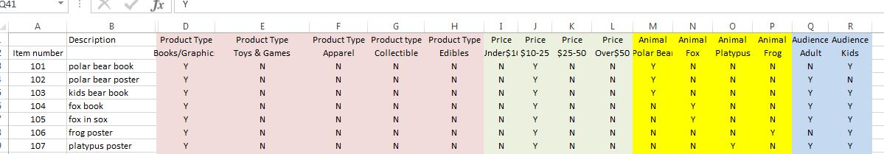
The gift store (Writing for a Database)
Collecting
  Skill used in creating any searchable database
  For this assignment, each student finds 10 pictures of items to sell in their gift store.
Tagging

Slide 9
The gift store (Writing for a Database)
AIDA
  Attention – headline
  Interest – body text to sell
  Detail – concrete information (weight, size, etc.)
  Action – “Add to Cart”

Slide 10
Time left? Badges!
Microcredentials uses to document learning
Useful links:
  Mozilla Open Badges: http://openbadges.org/
  Mozilla Badge Kit: https://badgekit.org
  Credly: https://credly.com/
  Badges MOOC:https://www.coursesites.com/webapps/Bb-sites-course-creation-BBLEARN/courseHomepage.htmlx?course_id=_264998_1
  Mozilla Open Badges YouTube Channel:https://www.youtube.com/channel/UCf_U-by1d9mKfhSih4kJw3g/feed
  National Cities of Learning:http://citiesoflearning.org

Slide 11
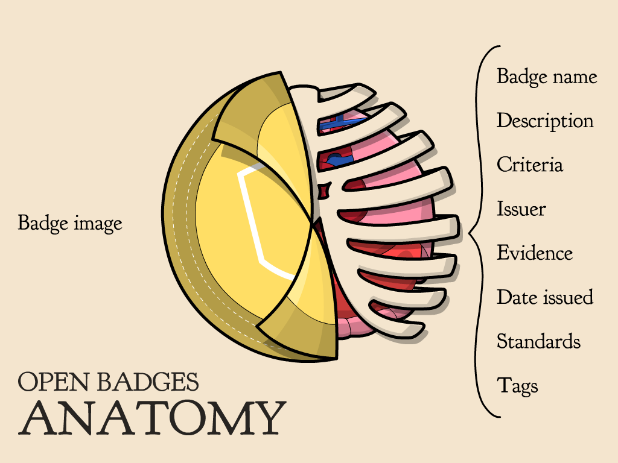
Time Left? Badges!

Slide 12
How are they used?
Badges are microcredentials used to document learning not captured in traditional transcripts
  Workplace
  Military
  Civic organizations
  Informal Education
  Formal Education
  Socially

Slide 13
Civic & Community Uses
Cities of Learning
  Chicago http://chicagocityoflearning.org/
  Los Angeles http://summeroflearning.la/
  Badges for Vets http://badgesforvets.org

Slide 14
Resources
Useful links:
  Mozilla Open Badges: http://openbadges.org/
  Mozilla Badge Kit: https://badgekit.org
  Credly: https://credly.com/
  Badges MOOC:https://www.coursesites.com/webapps/Bb-sites-course-creation-BBLEARN/courseHomepage.htmlx?course_id=_264998_1
  Mozilla Open Badges YouTube Channel:https://www.youtube.com/channel/UCf_U-by1d9mKfhSih4kJw3g/feed
  National Cities of Learning:http://citiesoflearning.org

