Slide 1
Video Games, Composition, and the Rise of Polythesesism: New Media Tools and Writing to Explore
Presented at CCCC 2017 Portland, OR Maureen Fitzpatrick Professor, English Johnson County Community College

Slide 2
Polythesisism – n.
an openness to multiple interpretations of a set of facts or observations; the willingness to generate assorted and contradictory paths through the widest expanse of knowledge one can collect; entirely made up word interesting enough to get a proposal accepted at 4Cs.

Slide 3
Game are about:
Creating a world that encourages exploration.
De-emphasizing linear process
Making failure—particularly spectacular failure—part of the learning process
Cultivating habits of learning

Slide 4
RPG Commandments circa 1998 -- Game Designer Warren Spector
Each player's path through the story must be unique.
Players must always have clear goals.
The level of interactivity must be high,
The central character must grow and change in ways that matter to players in an obvious and personal way.
The game must be about something more than killing things, solving puzzles, a---nd maxing out a character's statistics.

Slide 5
The Deus Ex Rules of Roleplaying. --Spector 2013
Always Show the Goal - Players should see their next goal (or encounter an intriguing mystery) before they can achieve (or explain) it.
Problems not Puzzles - It's an obstacle course, not a jigsaw puzzle. Game situations should make logical sense and solutions should never depend on reading the designer's mind.
Multiple solutions - There should always be more than one way to get past a game obstacle. Always. Whether preplanned (weak!), or natural, growing out of the interaction of player abilities and simulation (better!) never say the words, “This is where the player does X” about a mission or situation within a mission.
No Forced Failure - Failure isn't fun. Getting knocked unconscious and waking up in a strange place or finding yourself standing over dead bodies while holding a smoking gun can be cool story elements, but situations the player has no chance to react to are bad. Use forced failure sparingly, to drive the story forward but don't overuse this technique!
It's the Characters, Stupid - Roleplaying is about interacting with other characters in a variety of ways (not just combat… not just conversation…). The choice of interaction style should always be the player's, not the designer's.
Players Do; NPCs Watch - It's no fun to watch an NPC do something cool. If it's a cool thing, let the player do it. If it's a boring or mundane thing, don't even let the player think about it - let an NPC do it.
Games Get Harder, Players Get Smarter - Make sure game difficulty escalates as players become more accustomed to the interface and more familiar with the game world. Make sure player rewards make players more powerful as the game goes on and becomes more difficult. Never throw players into a situation their skills and smarts make frustratingly difficult to overcome.
Pat Your Player on the Back - Random rewards drive players onward. Make sure you reward players regularly and frequently, but unpredictably. And make sure the rewards get more impressive as the game goes on and challenges become more difficult.
Think 3D - An effective 3D level cannot be laid out on graph paper. Paper maps may be a good starting point (though even that's under limited circumstances). A 3D game map must take into account things over the player's head and under the player's feet. If there's no need to look up and down - constantly - make a 2D game!
Think Interconnected - Maps in a 3D game world feature massive interconnectivity. Tunnels that go direct from Point A to Point B are bad; loops (horizontal and vertical) and areas with multiple entrance and exit points are good.

Slide 6
Chris Bateman, Imaginary Games, 2011
Megatexts are fictional (think Star Trek, Harry Potter, etc) or nonfiction (scientific discoveries) stories, experiments or fact that we navigate between to discover new or larger texts.

Slide 7
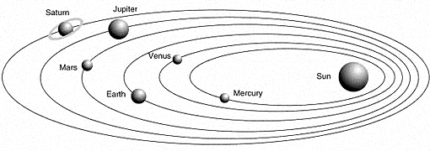
Coming to a dataset with an established thesis
Pre-Kepler
Post Kepler

Slide 8
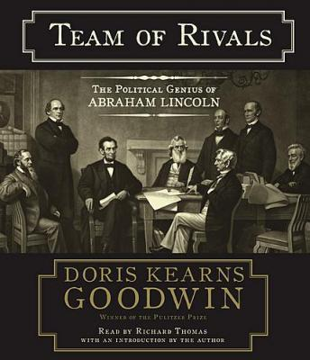
Coming to a dataset with no restrictions

Slide 9
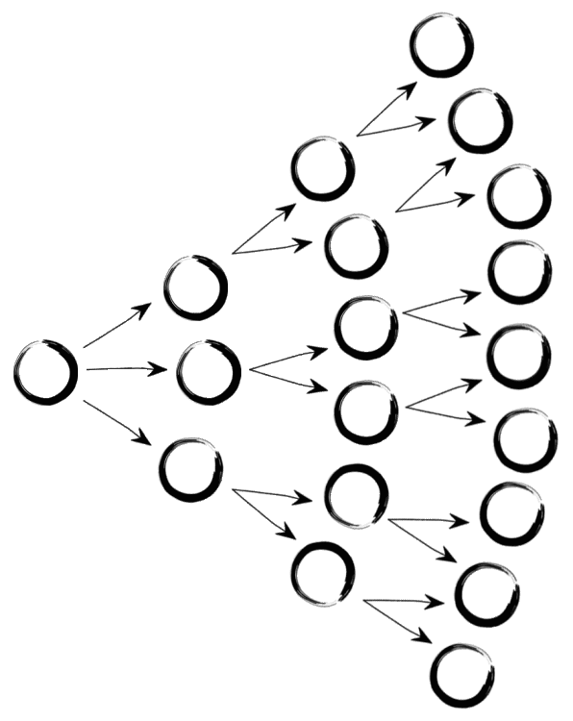
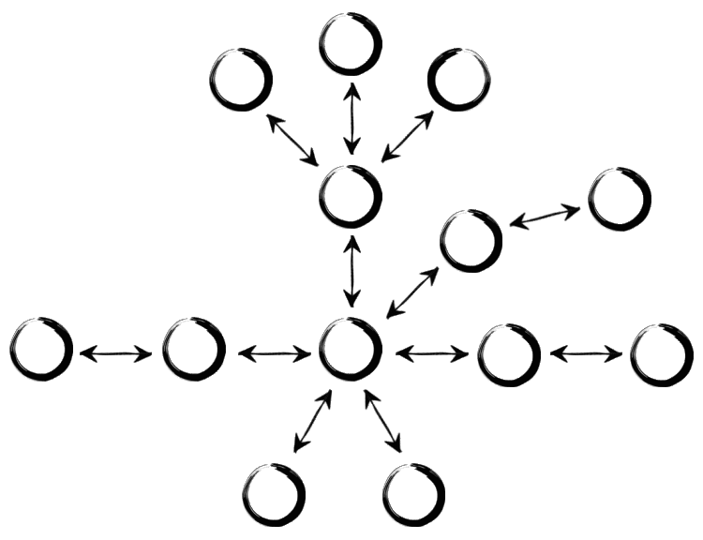
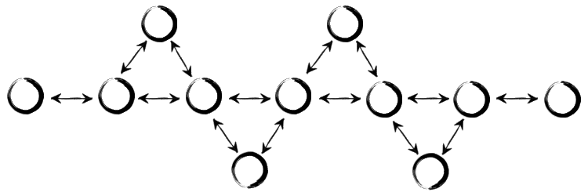
Structures
Linear | Parallel
Branching
 | Consentric (hub & wheel)
Fishbone (mini-game)

Slide 10
21st Century Skills, Henry Jenkins, Challenges of Participatory Culture
Play — the capacity to experiment with one’s surroundings as a form of problem-solving
Performance — the ability to adopt alternative identities for the purpose of improvisation and discovery
Simulation — the ability to interpret and construct dynamic models of real-world processes
Appropriation — the ability to meaningfully sample and remix media content
Multitasking — the ability to scan one’s environment and shift focus as needed to salient details.
Distributed Cognition — the ability to interact meaningfully with tools that expand mental capacities
Collective Intelligence — the ability to pool knowledge and compare notes with others toward a common goal
Judgment — the ability to evaluate the reliability and credibility of different information sources
Transmedia Navigation — the ability to follow the flow of stories and information across multiple modalities
Networking — the ability to search for, synthesize, and disseminate information
Negotiation — the ability to travel across diverse communities, discerning and respecting multiple perspectives

Slide 11
Linear Tools
Ativist – cloud, multiple chunks of story modes https://atavist.com/
Explory – linear but flexibly navigable timeline for multiple nodes, build in app www.explory.com
Odyssey – Map-driven storytelling platform, embed media http://cartodb.github.io/odyssey.js/
Prezi – presentation software; multiple types of media can be embedded www.prezi.com
Sway – (free with Office 365) PowerPoint & Prezi’s love child
Vojo – (crowd sourcing audio stories) http://vojo.co/
WeVideo – cloud-based video editor, app available www.wevideo.com

Slide 12
Nonlinear tools
Eko Studios (flash based), create non-linear stories with picture, sound, video -- https://studio.helloeko.com/
Inklewriter – text-based interactive storytelling http://www.inklestudios.com/inklewriter/
Twine – node-based interactive storytelling, text only, flowchart interface www.twinery.org
Vojo (crowd sourcing audio stories) http://vojo.co/

Slide 13
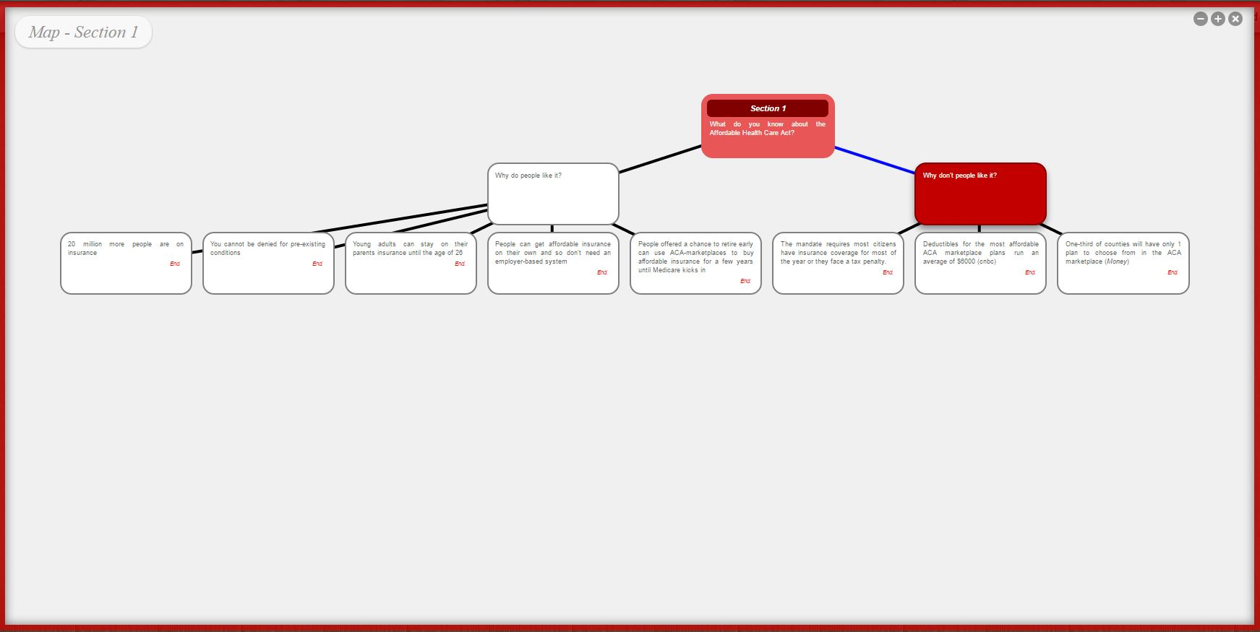
Inklewriter

Slide 14
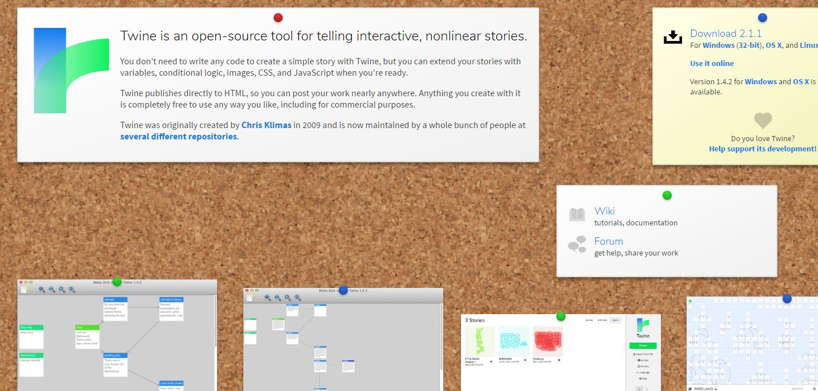
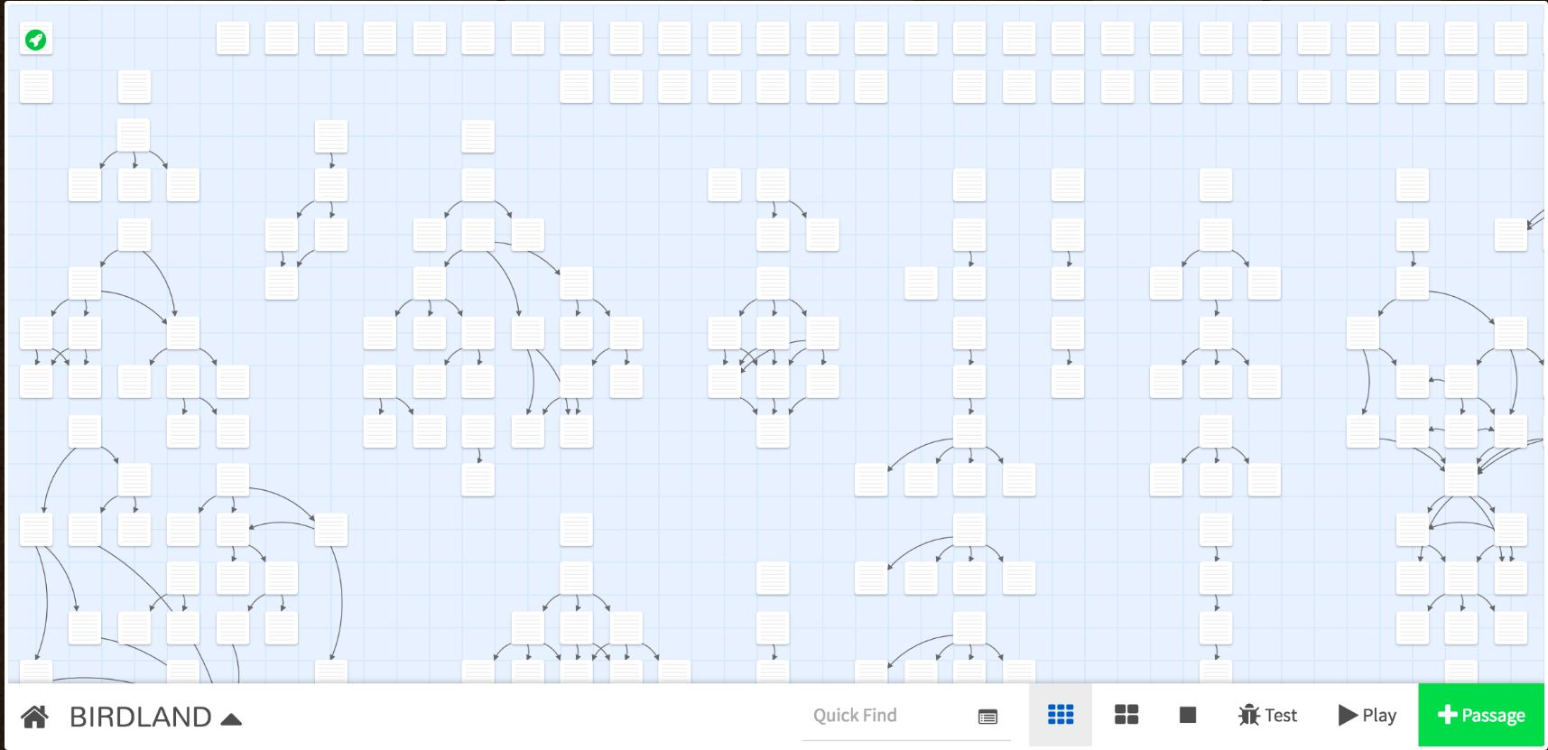
Twine

Slide 15
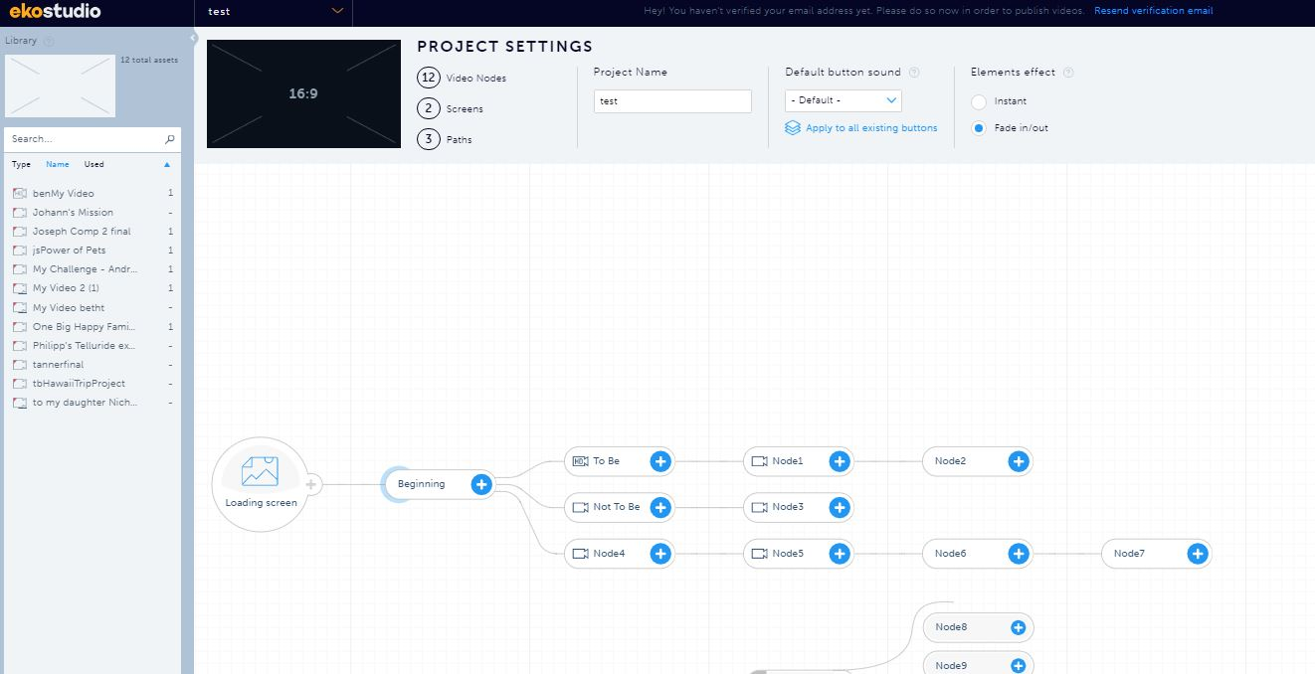
Eko Studios

Slide 16
iDocs: interactive documentaries
7 Deadly Sins http://digital-deadly-sins.theguardian.com/#/Grid
After the Storm http://www.pbs.org/independentlens/interactive/after-the-storm/#/dear-future-disaster-survivor

