Slide 1
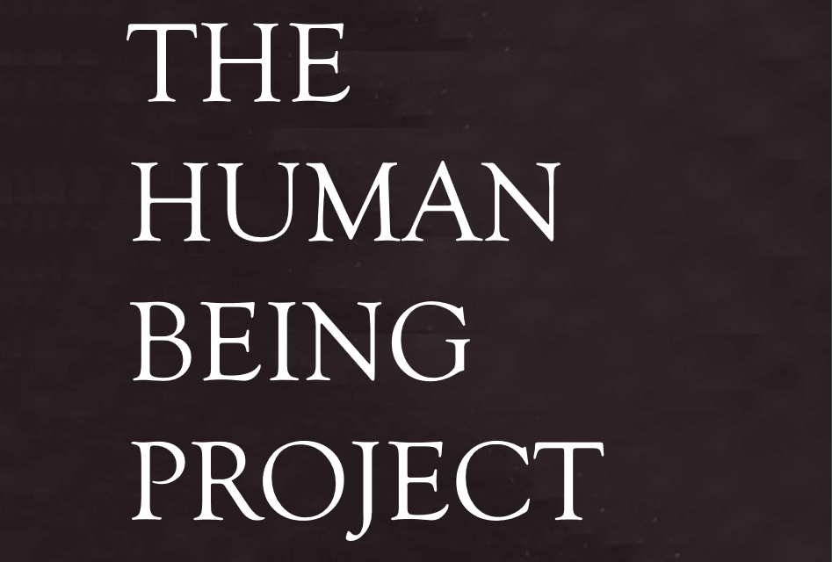

Slide 2
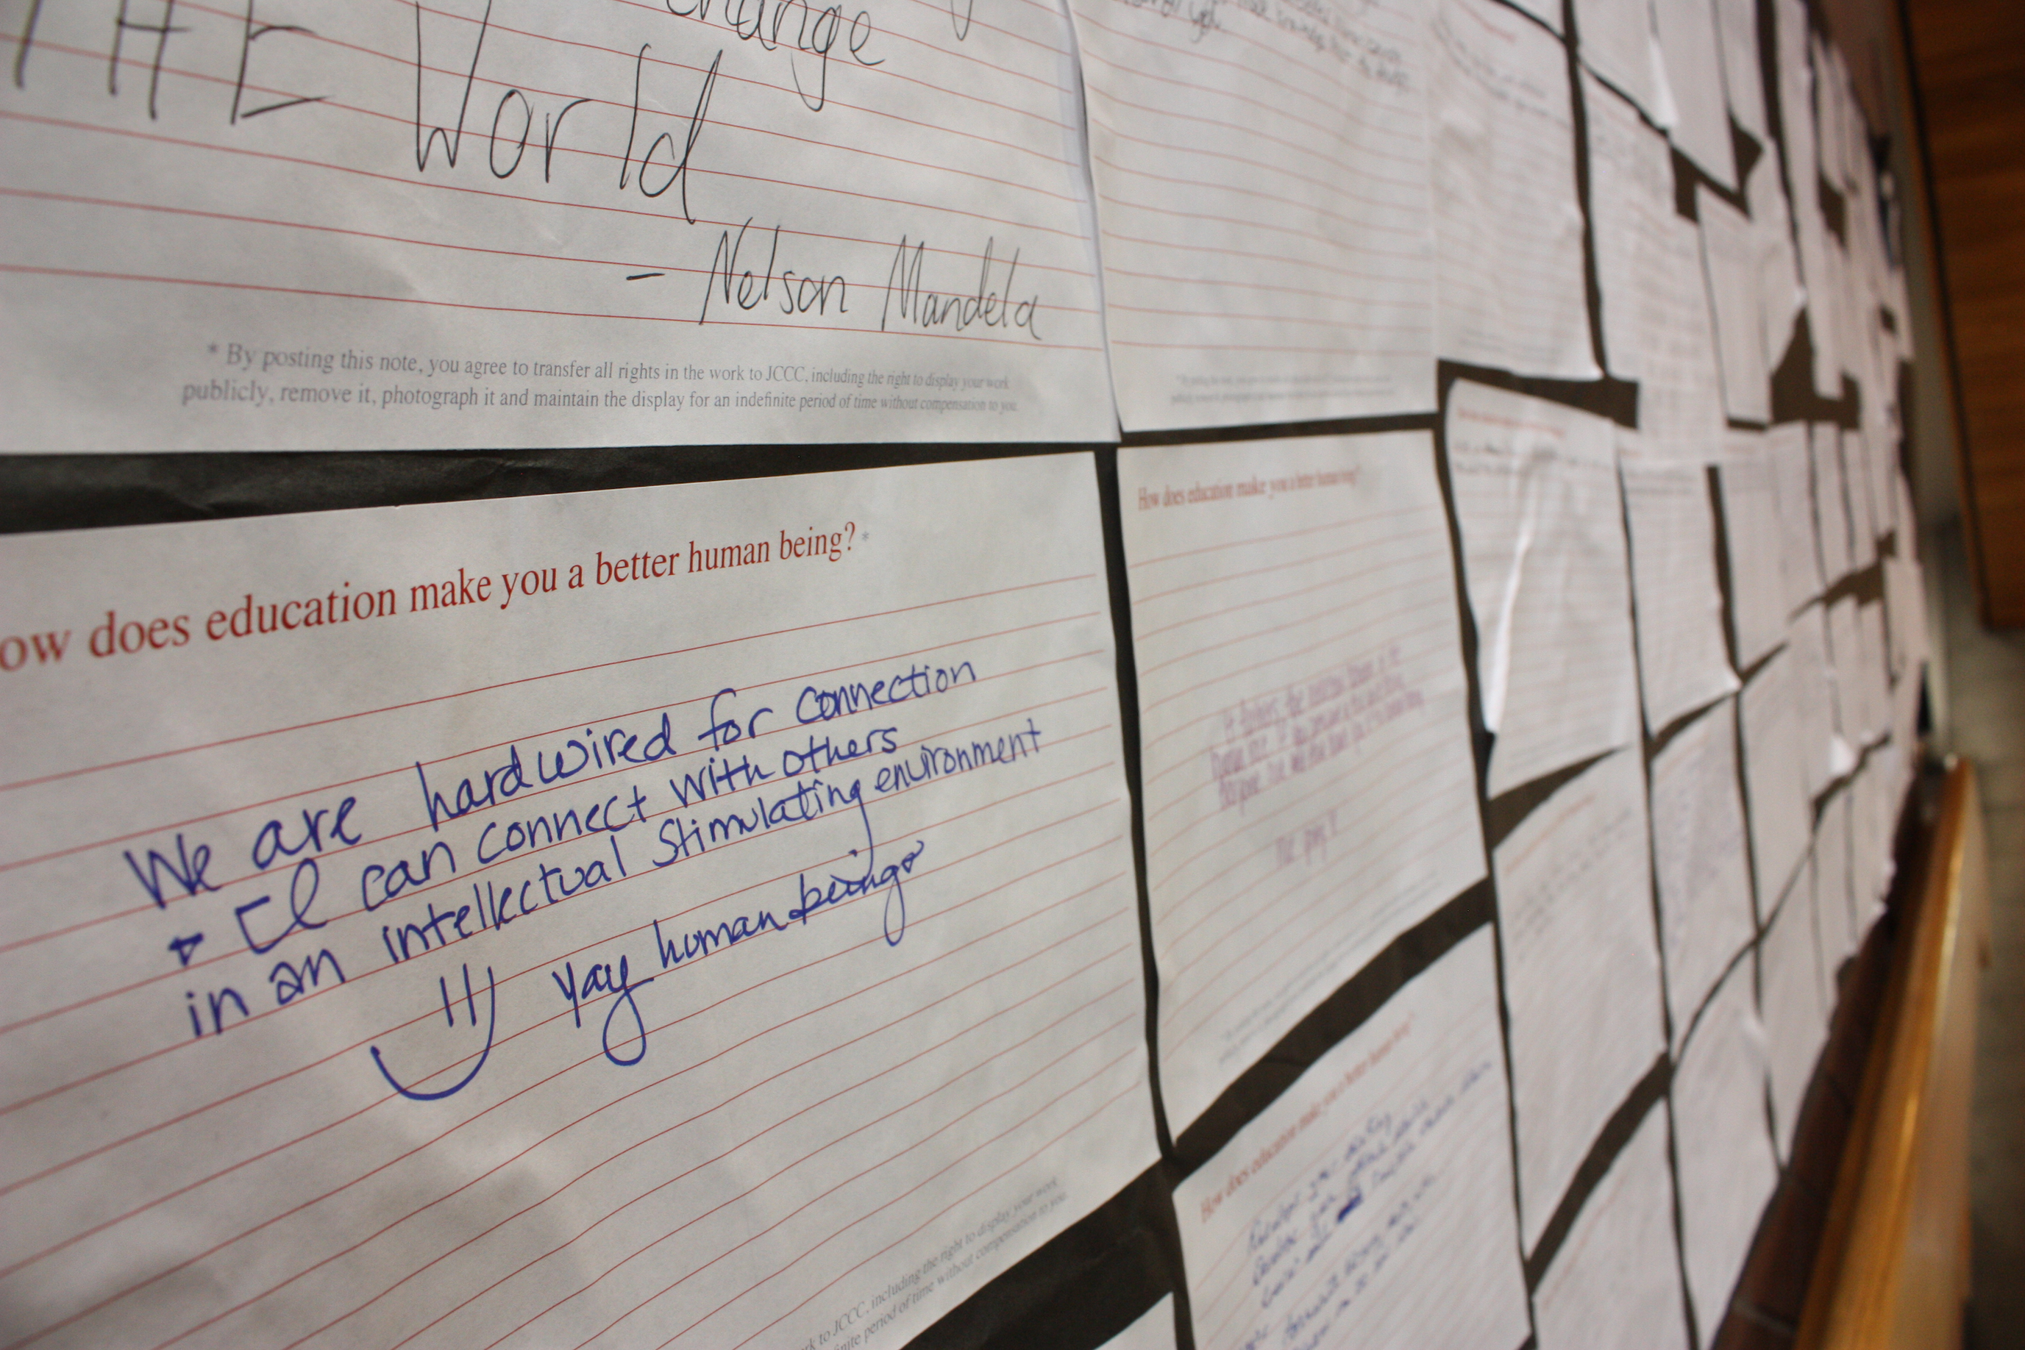

Slide 3
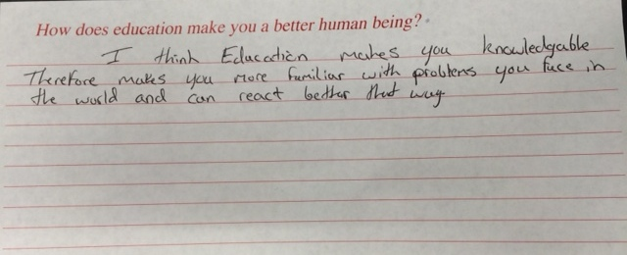
I think education makes you knowledgeable therefore makes you more familiar with problems you face in the world and can react better that way.

Slide 4
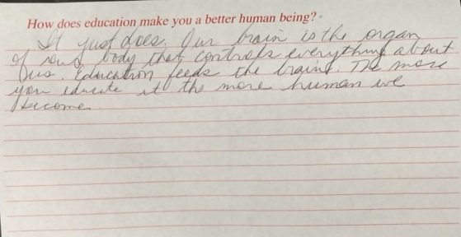
It just does. Our brain is the organ of our body that controls everything about us. Education feeds the brain. The more you educate it, the more human we become.

Slide 5
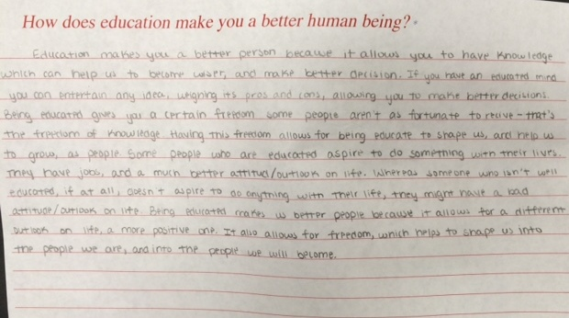
Being educated gives you a certain freedom some people aren’t as fortunate to receive - that’s the freedom of knowledge… People who are educated aspire to do something with their lives.

Slide 6
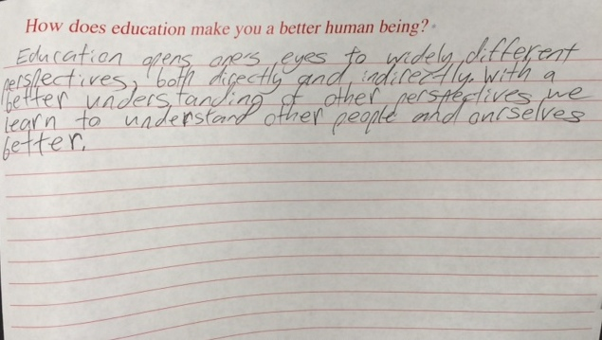
Education opens one’s eyes to widely different perspectives, both directly and indirectly. With a better understanding of other perspectives, we learn to understand other people and ourselves better.

Slide 7
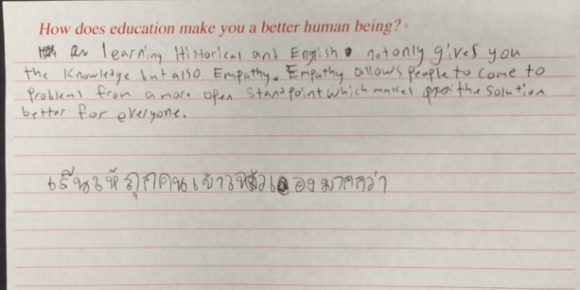
. . . Empathy allows people to come to problems from a more open standpoint which makes the solution better for everyone.

Slide 8
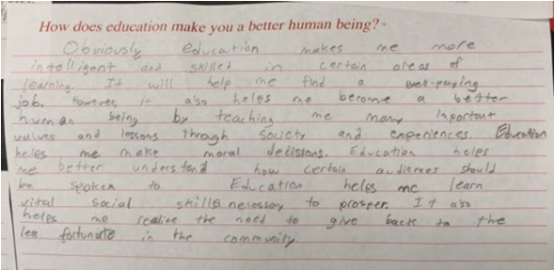
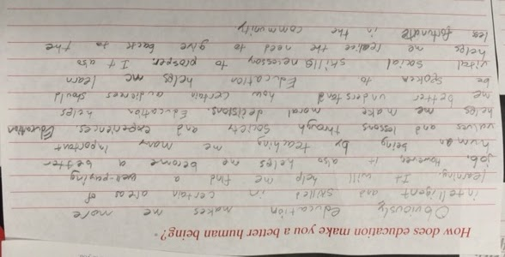
...it also helps me to become a better human being by teaching me many important values and lessons through society and experiences.

Slide 9
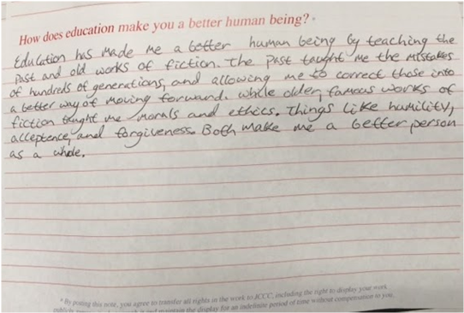
The past taught me the mistakes of hundreds of generations, and allowing me to correct those into a better way of moving forward. While older, famous works of fiction taught me morals and ethics. . . humility, acceptance, and forgiveness.

Slide 10
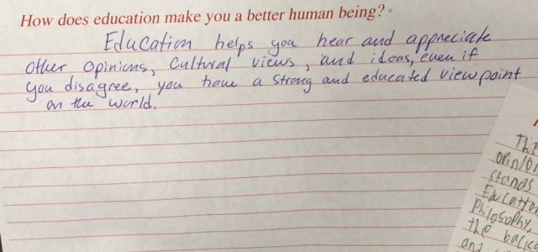
Education helps you hear and appreciate other opinions, cultural views, and ideas, even if you disagree....

Slide 11
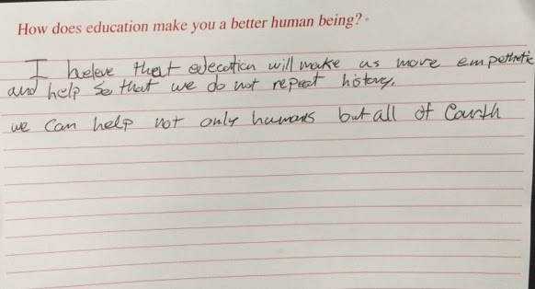
I believe that education will make us more empathetic….
We can help not only humans but all of
Earth.

Slide 12
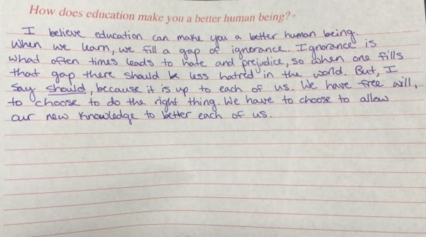
When we learn, we fill a gap of ignorance.

Slide 13
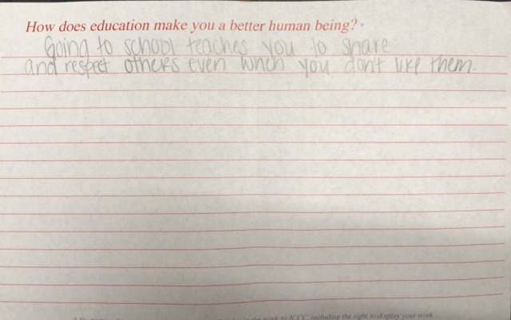
Going to school teaches you to share and respect others...

Slide 14
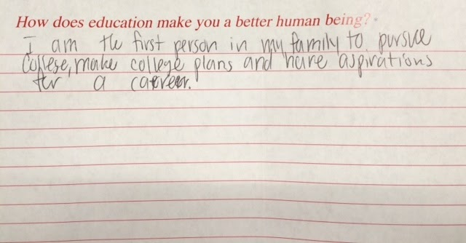
I am the first person in my family to pursue college… and have aspirations for a career!

Slide 15
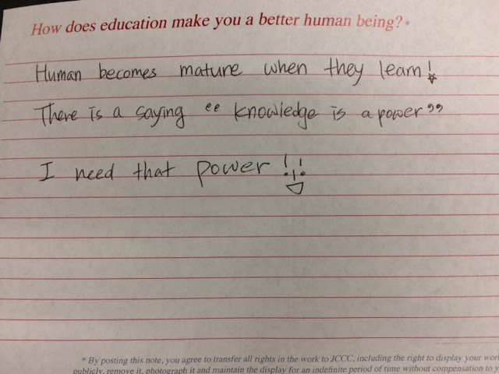
I need that power!!

Slide 16
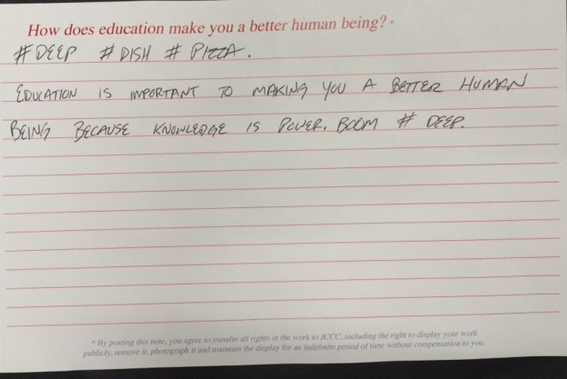
# DEEP # DISH
# Pizza
Knowldege is POWER. BOOM. #DEEP

Slide 17
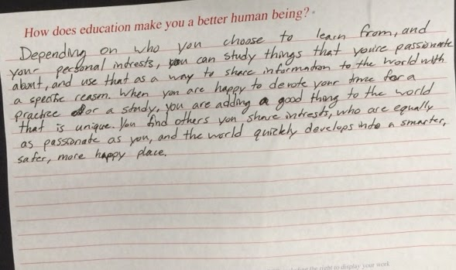
When you are happy to devote your time for a practice or study...the world quickly develops into a smarter, safer, more happy place.

Slide 18
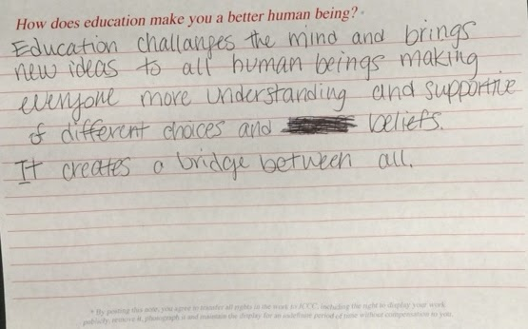
Education challenges the mind...It creates a bridge between all.

Slide 19
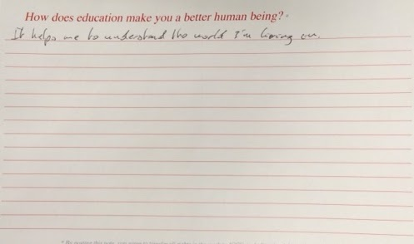
It helps me to understand the world I’m living on.

Slide 20
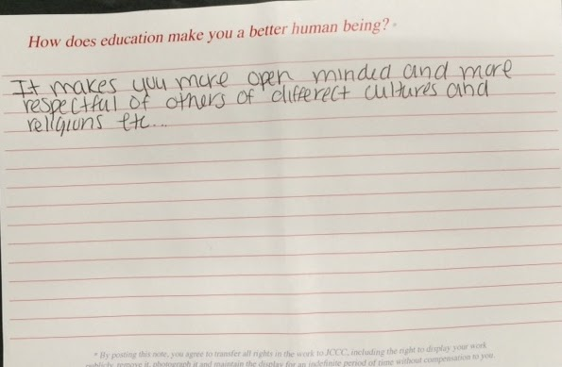
It makes you more open minded and more respectful of others of different cultures and religions...

Slide 21
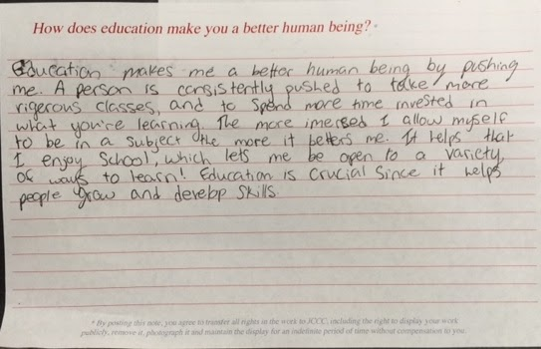
The more immersed I allow myself to be in a subject, the more it betters me.

Slide 22
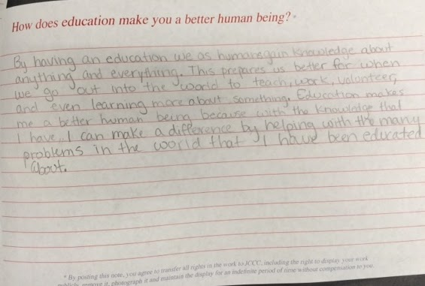
Education makes me a better human being because with the knowledge I have, I can make a difference….

Slide 23
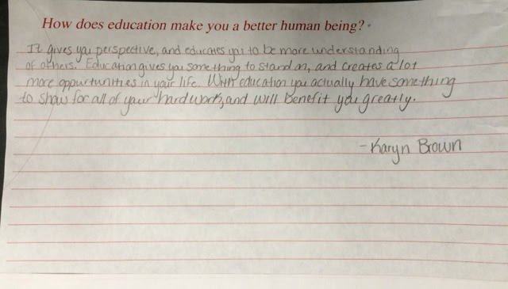
It gives you perspective...and gives you something to stand on….

Slide 24
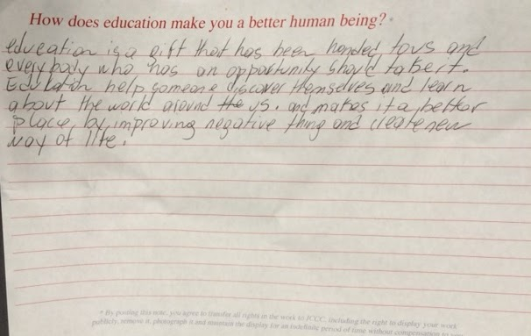
Education is a gift that has been handed to us and everybody who has an opportunity should take it...discover … and learn...

Slide 25
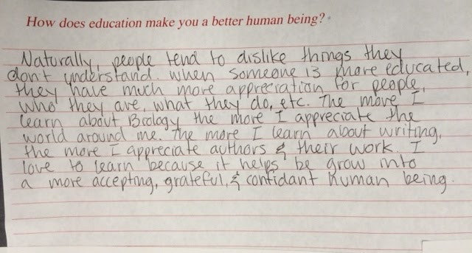
I love to learn because it helps me grow into a more accepting, grateful, and confident human being.

Slide 26
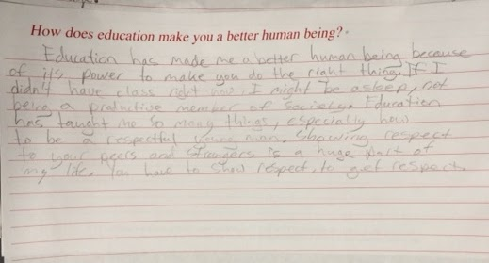
Education has made me a better human being because of its power to make you do the right thing.

Slide 27
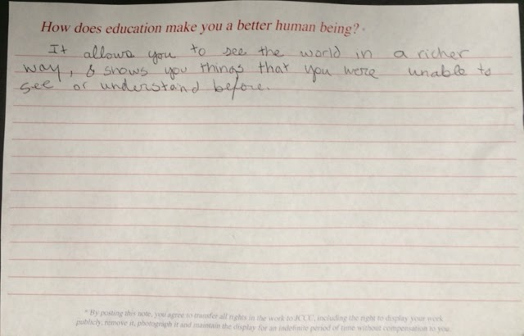
It allows you to see the world in a richer way. It shows you things that you were unable to see or understand before.

Slide 28
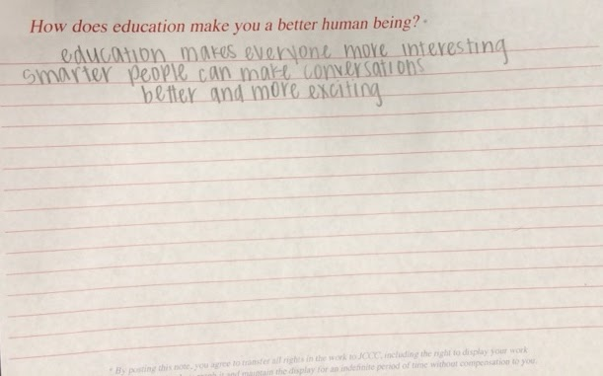
Education makes everyone more interesting...

Slide 29
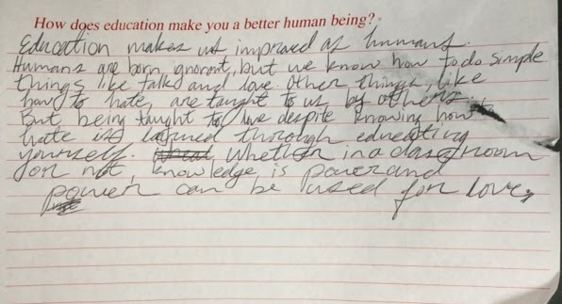
But being taught to love despite knowing how to hate is learned through educating yourself. Whether in a classroom or not, knowledge is power and power can be used for love.

Slide 30
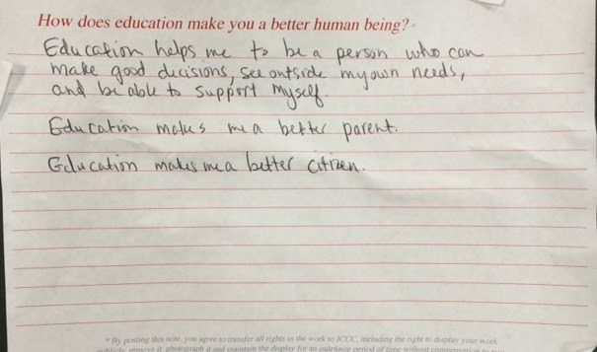
Education helps me to be a person who can make good decisions, see outside my own needs, and be able to support myself. Education makes me a better citizen.

Slide 31
Education helps me to be a person who can make good decisions, see outside my own needs, and...makes me a better citizen.

Slide 32
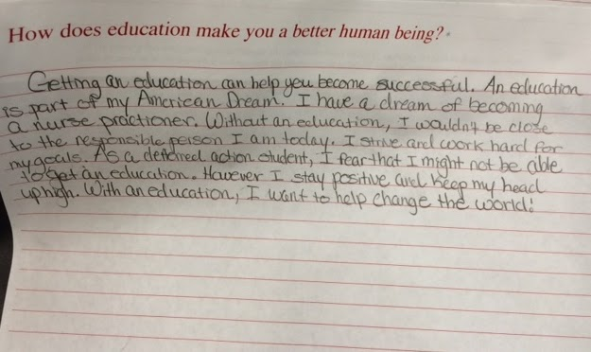
With an education, I want to change the world!

Slide 33
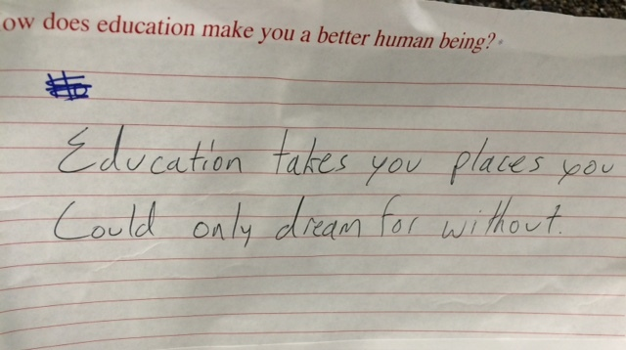
Education takes you places you could only dream for without.

