Slide 1
The Edge of Future Literacies
Maureen Fitzpatrick
Johnson County Community College
Indianapolis, IN -- TYCA-Midwest 2018

Slide 2
Digital Literacy > An NMC Horizon Project Strategic Brief
http://cdn.nmc.org/media/2016-nmc-horizon-strategic-brief-digital-literacy.pdf
Search terms:
NMC
Digital literacy

Slide 3
Digital Literacy
First define what you mean by digital literacy:
digital literacy =
digital tool knowledge
+ critical thinking
+ social engagement
+
+

Slide 4
What is “digital literacy”
Comfort with technology?
Fluent use of tools?
Ability to match digital tool to the right task?
The ability to be a critical consumer of media?
All true– but wait! There’s more!

Slide 5
American Library Association
ALA Digital Literacy Task Force defines digital literacy as the ability to use information and communication technologies to find, evaluate, create, and communicate information, requiring both technical and cognitive skills.

Slide 6
Vanderbilt
We define digital literacy (or, indeed, digital literacies) as a constellation of practices necessary for full participation in contemporary culture (social, political, workforce). In addition to computational skills, a digitally literate person has the capability to produce, curate, share and critically consume and synthesize information in a variety of digital (and non-digital) forms. Moreover, digital literacy includes a person’s ability to communicate ideas through multiple means of digital design and to decipher and critically reflect on mediated communication while also assessing their own ethical responsibilities in participating or sharing information.
Digital literacy is an educational expectation; it is required for all citizens, regardless of how often they communicate via digital means. Media ecologists indicate that the logic of a culture changes as its dominant media change, therefore the logic of contemporary culture is changing for everyone, regardless of media usage. Second, we assume that the means of communication themselves have a type of agency that acts upon, and alters, what it means to be human in each instance. People act “with” technologies, and technologies act “on” people. As a result, digital literacy must be an element of all education in the same way that literacy and reasoning must be.

Slide 7
Vanderbilt: microcredentials
Critical Digital Literacy—ability to assess and judge all elements of digital communication
Digital Visualization and Production—produce and consume messages via digital media and industry-level software
Computational thinking—types of thinking and thought processes that go into thinking through a problem and its solutions in ways that humans and machines can effectively carry out.

Slide 8
NMC: Skills that make up digital literacy
Critical thinking
Collaboration
Problem-solving
Creativity
Digital citizenship
Copyright knowledge

Slide 9
Universal literacy
Functional digital literacy
Can find, assess, and use information
Competent with basic productivity software—office productivity, image manipulation, social media

Slide 10
Creative literacy
Emphasizes the producer side
Advanced graphic, video, textual production skills
Develop social digital skills connected to digital citizenship, including online ethics, privacy and security issues, and building and maintaining an authentic and ethical digital identity.
Knowledgeable about copyright

Slide 11
Literacy across Disciplines
Diffuses digital literacy skills – consumer and creator skills – throughout the curriculum focusing on the “soft skills” like collaboration, critical thinking, problem-solving, and creativity

Slide 12
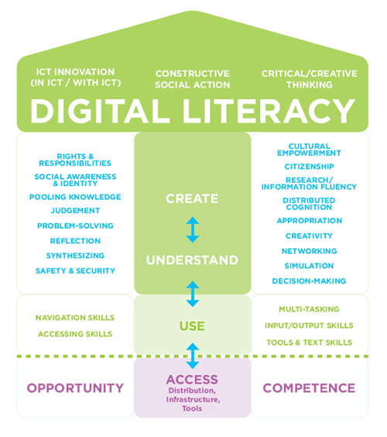
Digital Literacy Model from Media Studies

Slide 13
What is digital literacy?

Slide 14
How have your expectations about literacy changed since the Introduction of the internet?

Slide 15
What is your favorite digital tool to use in the classroom?

