Slide 1
Asking the Right Question - the Key to Good Assessment
Sheri Barrett, Johnson County Community College, Overland Park, KS
Melissa Giese, Metropolitan Community College, Kansas City, MO

Slide 2
Some things are the same everywhere…
Notes:
Melissa

Slide 3
Accrediting Bodies!
Higher Learning Commission (formerly North Central Association)
Middle States Commission on Higher Education
New England Association of Schools and Colleges
Southern Association of College and Schools
Western Association of Schools and Colleges
Northwest Accreditation Commission
Notes:
Melissa

Slide 4
Assessment of Student Learning
Criteria on Assessment is part of all 6 of the Regional Accrediting Bodies
Part of the requirements for Specialized Accrediting Agencies
Now includes “Co-curricular” learning outcomes
  4.B. The institution demonstrates a commitment to educational achievement and improvement through ongoing assessment of student learning.
  1. The institution has clearly stated goals for student learning and effective processes for assessment of student learning and achievement of learning goals.
  2. The institution assesses achievement of the learning outcomes that it claims for its curricular and co-curricular programs.
  3. The institution uses the information gained from assessment to improve student learning.
  4. The institution’s processes and methodologies to assess student learning reflect good practice, including the substantial participation of faculty and other instructional staff members.
Notes:
Melissa

Slide 5
Assessment – A Conceptual Framework
Notes:
Sheri

Slide 6
Cycle of Assessment
Question
Plan
Collect & Score
Analyze & Discuss
Act
Notes:
Sheri

Slide 7
Good assessment starts with a good question.
Questions to help focus assessment activities:
  What should students learn/gain from participation in the class/program/activity?
  How did it go?
  What evidence do you have?
  What are you doing with that evidence?
Notes:
Sheri

Slide 8
Devising an Assessment Question
The right question keeps the following in mind:
  Meaningful – it is a question that faculty/staff want to know the answer to, and that knowing the answer will help them impact learning.
  Measurable – work at asking a question that can be answered – usually that means narrowing down the question.
  Manageable – it is important to keep the question and the process of collecting data manageable.
Notes:
Melissa

Slide 9
Make sure the assessment is asking a question that can be answered
Narrow the scope
Too Broad: What attitudes do students need to possess to pass the problem-solving essay portion on the mid-term exam?
Narrower: What key concepts are students not understanding in the curriculum as reflected in the problem-solving essay portion of the mid-term?
Too Broad: Financial Aid staff will help at orientation with the goal of decreasing questions during the first week of classes.
Narrower: Financial Aid staff will participate in orientation with a section on most common questions with the goal of decreasing by 50% the questions during the first week of class.
Notes:
Melissa

Slide 10
Hands-On Exercise
Develop an assessment question based on your program.
  Peer Review
  Feedback.
  Final Version.
Notes:
Melissa

Slide 11
“The goal of assessment is information-based decision-making.”
Barbara Walvoord
Notes:
Sheri

Slide 12
Planning the Assessment
Understanding Your Assessment Toolbox
Managing Data Collection
After the Data – or What’s Next?
Notes:
Sheri – note materials in handouts

Slide 13
Tools in the Toolbox
Academic Assessment
  Pre/Post Test
  Embedded Questions
  Project Based Assignments
  Portfolios
  Surveys
  Performance
  Other Examples?
Student Affairs Assessment
Surveys
Needs Assessment
Satisfaction
Outcomes
Cost Effectiveness
Existing Data
Other Examples?
Notes:
Sheri

Slide 14
Manageable Data Collection
Start Simple
  Pilot methodology (survey, test instrument, rubrics, data collection)
  Work out the kinks.
  Develop a working hypothesis based on the first collection of data (in other words have an expectation).
Notes:
Sheri

Slide 15
Avoid over-collection of data
Choose only those variables that you have control over (this is based on your mission!)
Example – Open Access Community College
  Not Gender
  Not Age
  Not Socioeconomics
Notes:
Melissa

Slide 16
Next Steps
Discuss findings candidly.
Report on your findings.
Use the findings to improve curriculum/programs.
Exchange ideas freely.
Notes:
Sheri

Slide 17
Barriers to Success
Lack of time and sense of being overwhelmed
Insufficient knowledge of how to conduct assessment
Lack of central coordination of assessment
Striving for the perfect assessment project
Indeterminate assessment results
Skepticism about how evidence will be used
Notes:
Melissa

Slide 18
Robust discussion!
  What has worked well for you?
  What was a dismal failure?
  What are you trying now?

Slide 19
Data, Data Everywhere

Slide 20
The 3 most important things to do with data…
Visualize
Visualize
Visualize

Slide 21
Make Sure Your Data Charts are Accurate

Slide 22
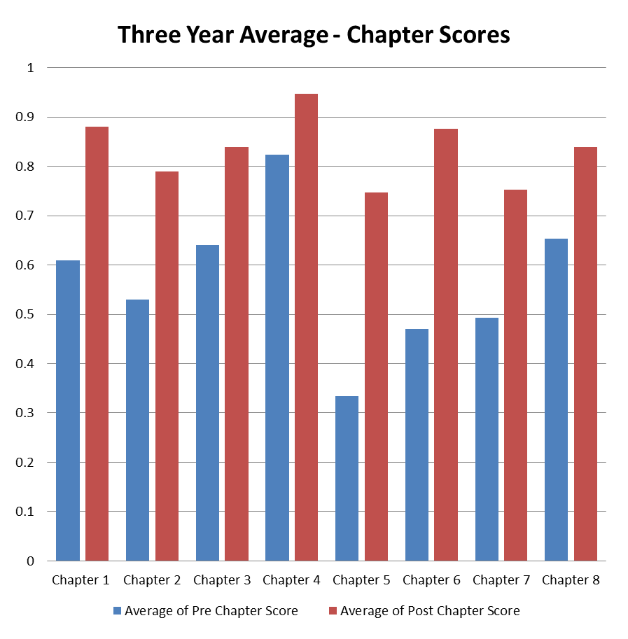
Look at the Data in Multiple Ways

Slide 23
Include What’s Important

Slide 24
Consider all the Implications/Causation

