Slide 1
Utilizing a Concept Inventory to Facilitate Data-Driven Course Improvement
Heather Seitz, Ph. D.
Associate Professor of Microbiology
Johnson County Community College

Slide 2
How do I know students are learning?
Notes:
Tell a story about how I got started in teaching and was very excited to try new things in the classroom and was energized and ready to share with colleagues. At my first national education meeting as an undergraduate faculty member I was faced with the daunting task of convincing my colleagues that my students “did better” when I used my teaching intervention. I quickly realized that “success”, “higher exam scores”, and “course grades” are artificial constructs that we use with no real validity. I had to dive deep to really think about what I wanted for my students, above wanting them to get an A, or score well on my exams I wanted them to think more like an expert in microbiology, I wanted them to truly understand the material. SO I sought out a way to measure this. I want my students to get an A, go to nursing school or wherever they are headed, I want them to do well on my exams but in the end what I truly want for my students is that they understand the course material better after my class than before. I had never heard of concept inventories before at this point and I went to some talks where they were discussed. I quickly searched the databases and realized that a concept inventory does not exist for my discipline. Therefore I started out on this journey to really answer the question “How do I know students are learning”

Slide 3
What is a concept inventory?
“Concept inventories are research-based instruments that measure students’ conceptual understanding of topics for which students share common misconceptions and faulty reasoning.”
D’Avanzo, C. (2008) Biology Concept Inventories: Overview, Status, and Next Steps. Bioscience, 58: 1079-1085.

Slide 4
What are the key features of a concept inventory?
Not just a test bank.
Simple to administer and easy to grade.
Often a multiple choice format or multiple true/false is used
Concepts measured are focused on key misconceptions.
Faculty must agree on most important concepts
Careful analysis is done to ensure validity and reliability.
Interviewing students helps to remove jargon.
Adams, W.K. & Wieman, C. E. (2010) Development and validation of instruments to measure learning of expert-like thinking. International Journal of Science Education, 1-24.
Notes:
I want to talk a little about what the literature says a concept inventory is. This is taken from a paper by Carl Wieman’s group in 2010.

Slide 5
History of Concept Inventories
1992- Force Concept Inventory is developed to measure physics concepts.
To date over 25 concept inventories exist.
They have been primarily developed in the scientific disciplines.

Slide 6
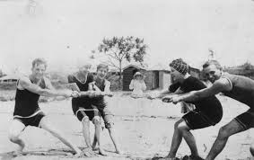
Steps for Concept Inventory Creation
Step One:
Establish topics that are important to faculty teaching the course.
Adams, W.K. & Wieman, C. E. (2010) Development and validation of instruments to measure learning of expert-like thinking. International Journal of Science Education, 1-24.

Slide 7
Step Two:
Identify student thinking about these topics and identify misconceptions.

Slide 8
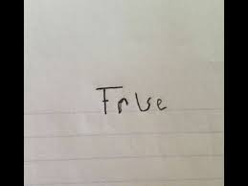
Step Three:
Create questions to probe student thinking more broadly in test form.

Slide 9
Step Four:
Create a forced answer test that measures
student thinking.

Slide 10
Step Five:
Carry out validation interviews with both novices and subject experts on the test questions.
Use think out loud protocol with students.
Subject experts don’t always agree!

Slide 11
______13. If a single nucleotide is mutated in a bacterial gene, which one of the following statements would be the most likely outcome?
A) Nitrogenous bases would be added to the gene sequence.
B) The protein product of the gene might not function properly.
C) The mutation would cause unregulated growth of the cells.
D) The bacteria would automatically become drug resistant.
E) I don’t know.
Please explain your answer choice:
Pre-test
Post-test

Slide 12
______13. If a single nucleotide is mutated in a bacterial gene, which one of the following statements would be the most likely outcome?
A) Nitrogenous bases would be added to the gene sequence.
B) The protein product of the gene might not function properly.
C) The mutation would cause unregulated growth of the cells.
D) The bacteria would automatically become drug resistant.
E) I don’t know.
Please explain your answer choice:
Student responses
The mutation of a nucleotide would cause the gene to not function properly.
The protein might lose its function because the base pairing was disrupted.
Because more genes would be bad for the bacteria
Yes, because it can code for an entirely different codon, then an entirely different amino acid, and a different protein.
Depending on the nucleotide, the mutation may or may not be harmful.
A single nucleotide being mutated could potentially alter the genes making the protein not function properly.

Slide 13
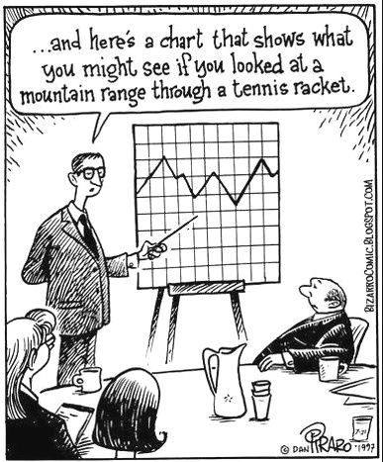
Step Six:
Administer to classes and run statistical tests on the results.

Slide 14
Psychometric Analysis: Item analysis
Difficulty Index (P)- How hard was the question?
Discrimination Index (D)- Measures discriminatory power of each question. Students that do well on the entire test should answer the question correctly compared with students who do poorly.
Reliability (Point biserial coefficient) Measures consistency of a single question with the whole test. Did students who answered this question correctly do better on the whole test?

Slide 15
How to find a troublesome question?

Slide 16
Course Level Assessment
Images are powerful.
Prepare for class or modify classroom strategy.
Metacognition.
Individualized study plan.
Notes:
Images- pictures can be important and give different information to uncover student understanding
Prepar– can use the pre-test or individual items to help uncover student misconceptions
Metacognition- help students understand that they don’t know and prepare them to learn
Individual study- guide students to tutorials, web tools, chapters based on areas that they hold more misconceptions in.

Slide 17
Course Level Assessment
Notes:
Tells us about learning gains in the classroom.

Slide 18
Faculty Learning Community
Instructor #1
Instructor #2
Notes:
Can have a lot of conversations and build community around

Slide 19
1. Are students making significant progress in a course? Compare pre and post scores
Course | Pre | Post | Sig.
General Microbiology - BSCI223/Fall 2006 (N=109, 16 questions) | 31.1+15.6 | 48.1+16.9 | <.001***
General Microbiology - BSCI223/Spring 2007 (N=127, 16 questions) | 31.9+15 | 44.2+19.4 | <.001***
General Microbiology - BSCI223/Fall 2008 (N=90, 18 questions) | 26.1+15.6 | 47.1+16.2 | <.001***
General Microbiology - BSCI223/Spring 2009 (N=107, 17 questions) | 30.1+14.8 | 49.1+14.1 | <.001***
Notes:
Data from the online CI are downloaded to excel files.
Pre- and posttest means are calculated for each course and tabulated (Table 3).
Student explanations for each question are sorted by distractor choice to facilitate qualitative analysis.
The HPI Community meets to review and discuss student performance on the CI. Quantitative data (pre- and posttest means) are reviewed and discussed by the group as a whole. For qualitative analysis, faculty members work in pairs to read and discuss student responses to different subsets of CI questions. Each pair then reports their major findings to the entire group for additional discussion. By examining the reasoning behind students’ choices, we have begun to recognize common misconceptions that lead students to select particular distractors.

Slide 20
3. Are students retaining concept knowledge? Compare post score to pre score
Course | Pre | Post | Sig.
General Microbiology - BSCI223/Fall 2006 (N=109, 16 questions) | 31.1+15.6 | 48.1+16.9 | <.001***
General Microbiology - BSCI223/Spring 2007 (N=127, 16 questions) | 31.9+15 | 44.2+19.4 | <.001***
General Microbiology - BSCI223/Fall 2008 (N=90, 18 questions) | 26.1+15.6 | 47.1+16.2 | <.001***
General Microbiology - BSCI223/Spring 2009 (N=107, 17 questions) | 30.1+14.8 | 49.1+14.1 | <.001***
Immunology Lecture - BSCI422/Spring 2007 (N=48, 16 questions) | 59.9+19.4 | 64.3+21.9 | <.05*
Immunology Lecture - BSCI422/Spring 2008 (N=53, 18 questions) | 53.7+16.9 | 56.6+17.8 | .132
Immunology Lecture - BSCI422/Spring 2009 (N=31 , 17 questions) | 58.8+15.7 | 61.6+16.4 | .572

Slide 21
4. Are students making progress in all concepts?
C2: Diverse microbes use common themes to interact with the environment (host) C12: Immune response recognizes general properties (common themes vs specific attributes: innate vs adaptive
C9,10
C12
C13
C3,4,10
C13
C1: The structural characteristics of a microbe are important in the pathogenicity of that microbe
C11
C7,11,12
C6
C4,5,9,12
C10
C8
C7,9
C10: Microbes adapt/respond to the environment by altering metabolism.
C3
C2,3
C3,4,10

Slide 22
Look at distractor choices to gain insights for curriculum reform
Spring 2010 | 223 |  | 412 |  | 422 |  | 425 |  | 437 |  | MC
Number of Students | Pre 207 | Post 242 | Pre 28 | Post 9 | Pre 64 | Post 56 | Pre 45 | Post 36 | Pre 45 | Post 44 | Pre | Post 53
Which is _*NOT*_ true about the evolution of antibiotic resistance in bacterial populations? It can be mediated by
selective growth of bacteria capable of degrading antibiotics | 24.6 | 21.9 | 28.6 | 33.3 | 28.1 | 25 | 26.7 | 27.8 | 40.0 | 25.6 | 21.2 | 27.5
alterations of a bacterium’s genetic material through mutation | 6.3 | 7 | 3.6 | 0 | 9.4 | 8.9 | 8.9 | 8.3 | 13.3 | 4.7 | 8.2 | 9.8
changes in gene expression that occur in the presence of antibiotics. | 20.8 | 49.2 | 57.1 | 55.6 | 46.9 | 55.4 | 28.9 | 50 | 31.1 | 44.2 | 16.5 | 33.3
modification of a bacterium’s genome through uptake of new genetic information | 12.1 | 11.2 | 3.6 | 0 | 6.3 | 8.9 | 22.2 | 11.1 | 8.9 | 11.6 | 16.5 | 21.6
I do not know the answer to this question. | 35.7 | 10.7 | 7.1 | 11.1 | 9.4 | 1.8 | 11.1 | 2.8 | 6.7 | 14 | 31.8 | 7.8
Notes:
22

Slide 23
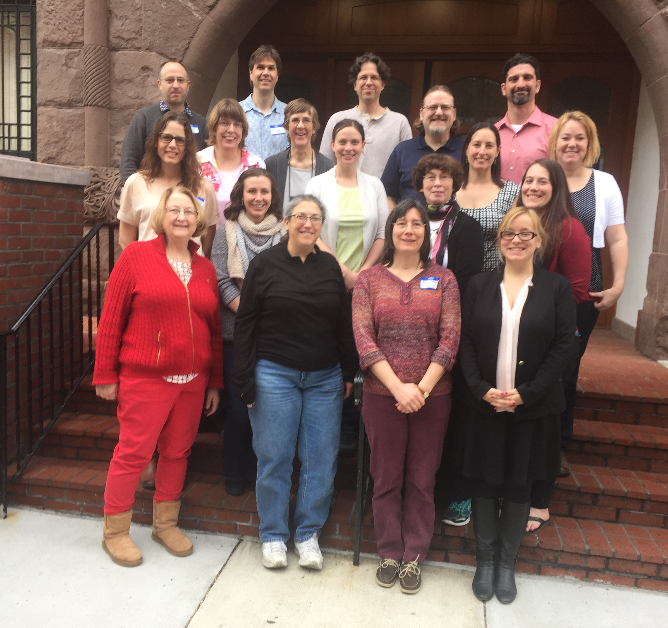
Thank You!
Microbiology for Health Sciences Concept Inventory
Heather Seitz, Task Force Facilitator
Rachel Horak, American Society for Microbiology
Jeffrey Pommerville, Glendale Community College
Lucy Kluckhohn-Jones, Santa Monica College
Maureen Whitehurst, Trident Technical College
Andrea Pratt-Rediske, University of Central Florida
Megan Howard, Battelle Memorial Institute
Microbiology Concept Inventory
Tim Paustian, University of Wisconsin
Ann Smith, Virginia Tech University

