Slide 1
Assessment and Campus-Wide Engagement: Incorporating a Center for Teaching and Learning
Jelena Ozegovic, Ph.D., Co-Coordinator of Academic Assessment and Faculty Director for The Center for Teaching Excellence
Tiffany Bohm, DPT, Co-Coordinator of Academic Assessment and Dean of Health Professions & Continuing Education
Tom Grady, M.S., Faculty Assistant Director of the Center for Teaching Excellence
Julian Gonzalez, M.A., Coordinator of the Center for Teaching Excellence

Slide 2
The Center for Teaching Excellence
Mission: To foster academic discourse specific to the craft of teaching while leveraging technology, academic assessment, and professional learning to enhance pedagogy and student learning. Founded AY 2016-2017

Slide 3
The Center for Teaching Excellence
3 Pillars of the Center the will drive service:
Craft and Practice of Teaching
*Blue Devil Faculty Academy (New; Mid-Career; Late-Career; Adjunct)
Academic Assessment
*Creating a culture of assessment. Establishing an AAC that is faculty-led
*Using LMS (Blackboard) for course level assessment. *Coming soon…General Education Assessment and other Institutional Outcomes
Academic Discourse *Academic Symposiums, Critical Issues Panels, Common Read Project

Slide 4
Academic Assessment: “Branding”
KCKCC History of Cardiac Assessment
Changing the mindset and getting “buy-in.”
*Marketing concept of “branding” and trying to convey this to Faculty.
Goal of Assessment: To inform curriculum, teaching, and learning

Slide 5
Academic Integrity and Assessment at KCKCC
KCKCC Institutional Assessment and the Center for Teaching Excellence:
KCKCC Academic Integrity Structure
4-legged stool:
Academic Policies Committee;
Core Curriculum Council;
Academic Assessment Council;
Program Review Committee
Transparency in Assessment

Slide 6
Pillar 1: Craft of Teaching
Scholarship of Teaching and Learning (SOTL)
What learning goal was achieved as a result of a pedagogical change or practice that allowed the change to occur. (Schwartz & Haynie, 2013)
A shift toward learning can lead to useful assessment measures for determining the impact of change in teaching (Hutchings, Huber, & Ciccone, 2011)
Promoting SOTL, the use of evidence to demonstrate and evaluate student learning, dovetails the increased focus on assessment. (Schwartz & Haynie, 2013)

Slide 7
Pillar 2: Academic Assessment
KCKCC Assessment and the Center for Teaching Excellence
Course level assessment (phase 1)
Academic Assessment Council (AAC)--newly established in Fall 2016
Program level assessment (on-going, particularly in accredited programs)
Institutional assessment (phase 2)
General Education
2 year General Education Review 2015-2017
Recommendation to develop a Core Curriculum Council (CCC). Beginning in Fall 2017
CCC will determine method of General Education Assessment
New requirement: Gen Ed courses must meet 3 of 6 Gen Ed Outcomes to be accepted into core. Reviewed by CCC

Slide 8
Blackboard and Course Assessment
Using the Blackboard Course Outcomes Assessment Module. Replaced Student Competency Index of years past.
Starting with FT faculty this semester. In AY 2017-2018 will begin training adjunct faculty.
Department selected to use either Outcomes OR Outcomes & Competencies
KBOR aligned courses, Outcomes cannot be changed/modified
Courses not KBOR aligned can be changed/modified.
Spurred Departmental conversations about outcomes
New data collection method Requires the use of the Grade Center in Blackboard
“View and Add Alignments” to denote Outcomes to every assignment, test, etc.
Once Alignments have been added, copy from semester to semester.
Institutional Reports/data provided to Coordinator for “closing the loop” conversations

Slide 9
Reports in Blackboard
Instructor Reports: See KCKCC Center for Teaching Excellence YouTube videos. You can Google us!
Not a commercial for BB. But, the goal was to provide faculty with the tools to assess their own students and easily access their OWN data…leading to building the culture of assessment on campus.
Course Coverage Report Provide a report to see if all the Outcomes have been “aligned” to an assignment, test score, activity, etc. Note: Do NOT have to test using BB. Just post a score for the Test grade in the Grade Center.
Course Performance Report Provides information on how the entire class is performing on the Outcomes based on the “alignments” added to items in the Grade Center.
Goal Performance Report Report for each individual student performance on Outcomes for the course. Each student can also access their own Goal Performance report. Can help them to study, etc.

Slide 10
What percentage of FT Faculty do you believe completed the Assessment Revamp?

Slide 11
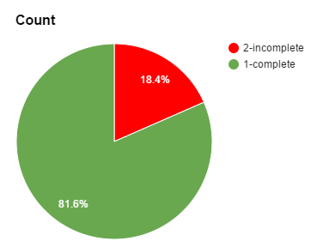
The CTE In Numbers
82% FT Faculty Completed Assessment Revamp

Slide 12
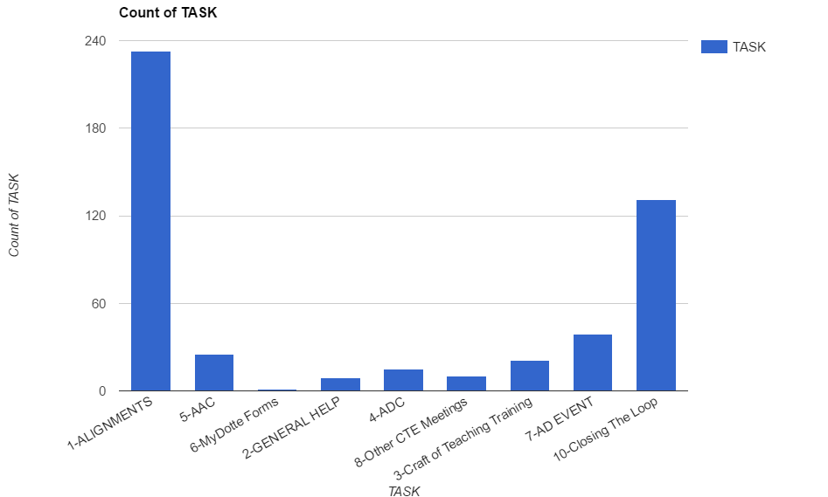
The CTE In Numbers
495 Total

Slide 13
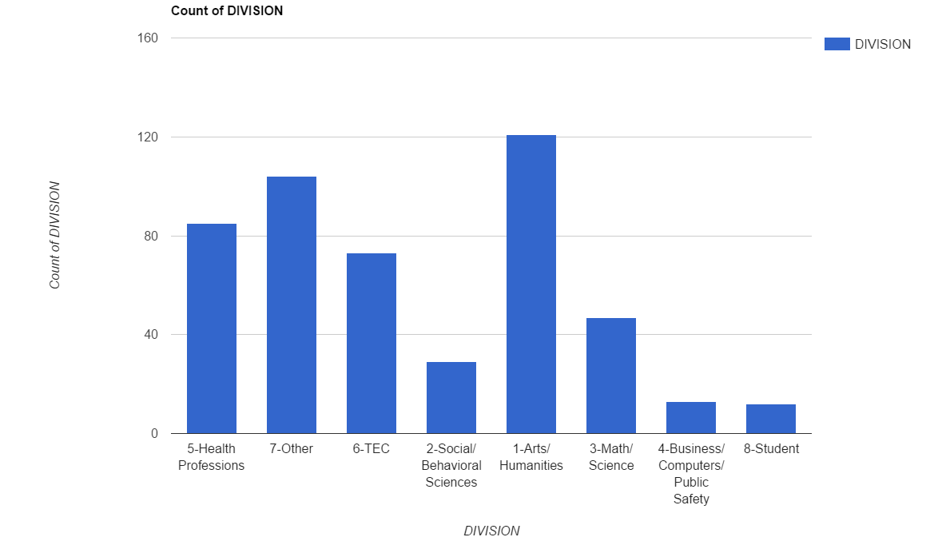
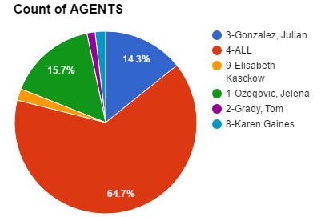
The CTE In Numbers
495 Total

Slide 14
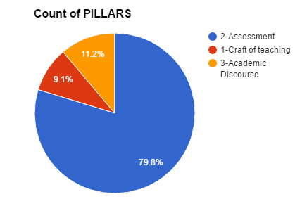
The CTE In Numbers (since Nov. 1, 2016)
355 assessment based interactions
Assessment Pillar 80% of our tasks
495 total individual encounters for 3 pillars
65% of our effort is team (group) lead
442 Views:
Adding Alignments
Creating Rubrics
Running Course Reports

Slide 15
Timeline for Assessment Revamp
*January 2016 HLC Reaccreditation Report. *April 2016 KCKCC Center for Teaching Excellence (CTE) proposal with 3 pillars of service accepted. *July 2016 Construction begins on “inner” CTE. *August 2016 HLC Reaccreditation Report discussed with FT faculty with attention focused on course level assessment. *October 2016, new Co-Coordinators named for Academic Assessment at KCKCC (Bohm & Ozegovic) and Academic Assessment Council (AAC) established with a FT faculty member from each Division. *November 2016 Coordinator for CTE hired (Gonzalez). *December 2016 FT Faculty informed of the use of LMS for data collection and create a form to submit Outcomes or Outcomes & Competencies. *January-March 2017 FT Faculty Trained (in-person/video) using LMS to “align” course Outcomes. *January 2017 Faculty Assistant Director for the CTE hired (Grady) *February 2017 construction begins on “outer” CTE. *April 2017 FT Faculty trained on running course reports and reviewing course level data for each student and in aggregate. Submit a form that asks them to review results and determine strengths/weaknesses of process.
Other contributing factors to “revamp”: Gen Ed Curriculum Review and recommendation for a Core Curriculum Council and plan to revamp the General Education Outcomes and General Education Assessment.

