Slide 1
Automating Data Collection and Reporting to Promote Faculty Engagement in Assessment
Frederick Burrack – Director
Chris Urban – Assistant Director

Slide 2
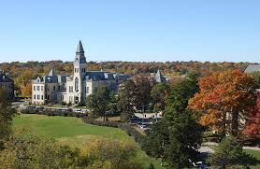
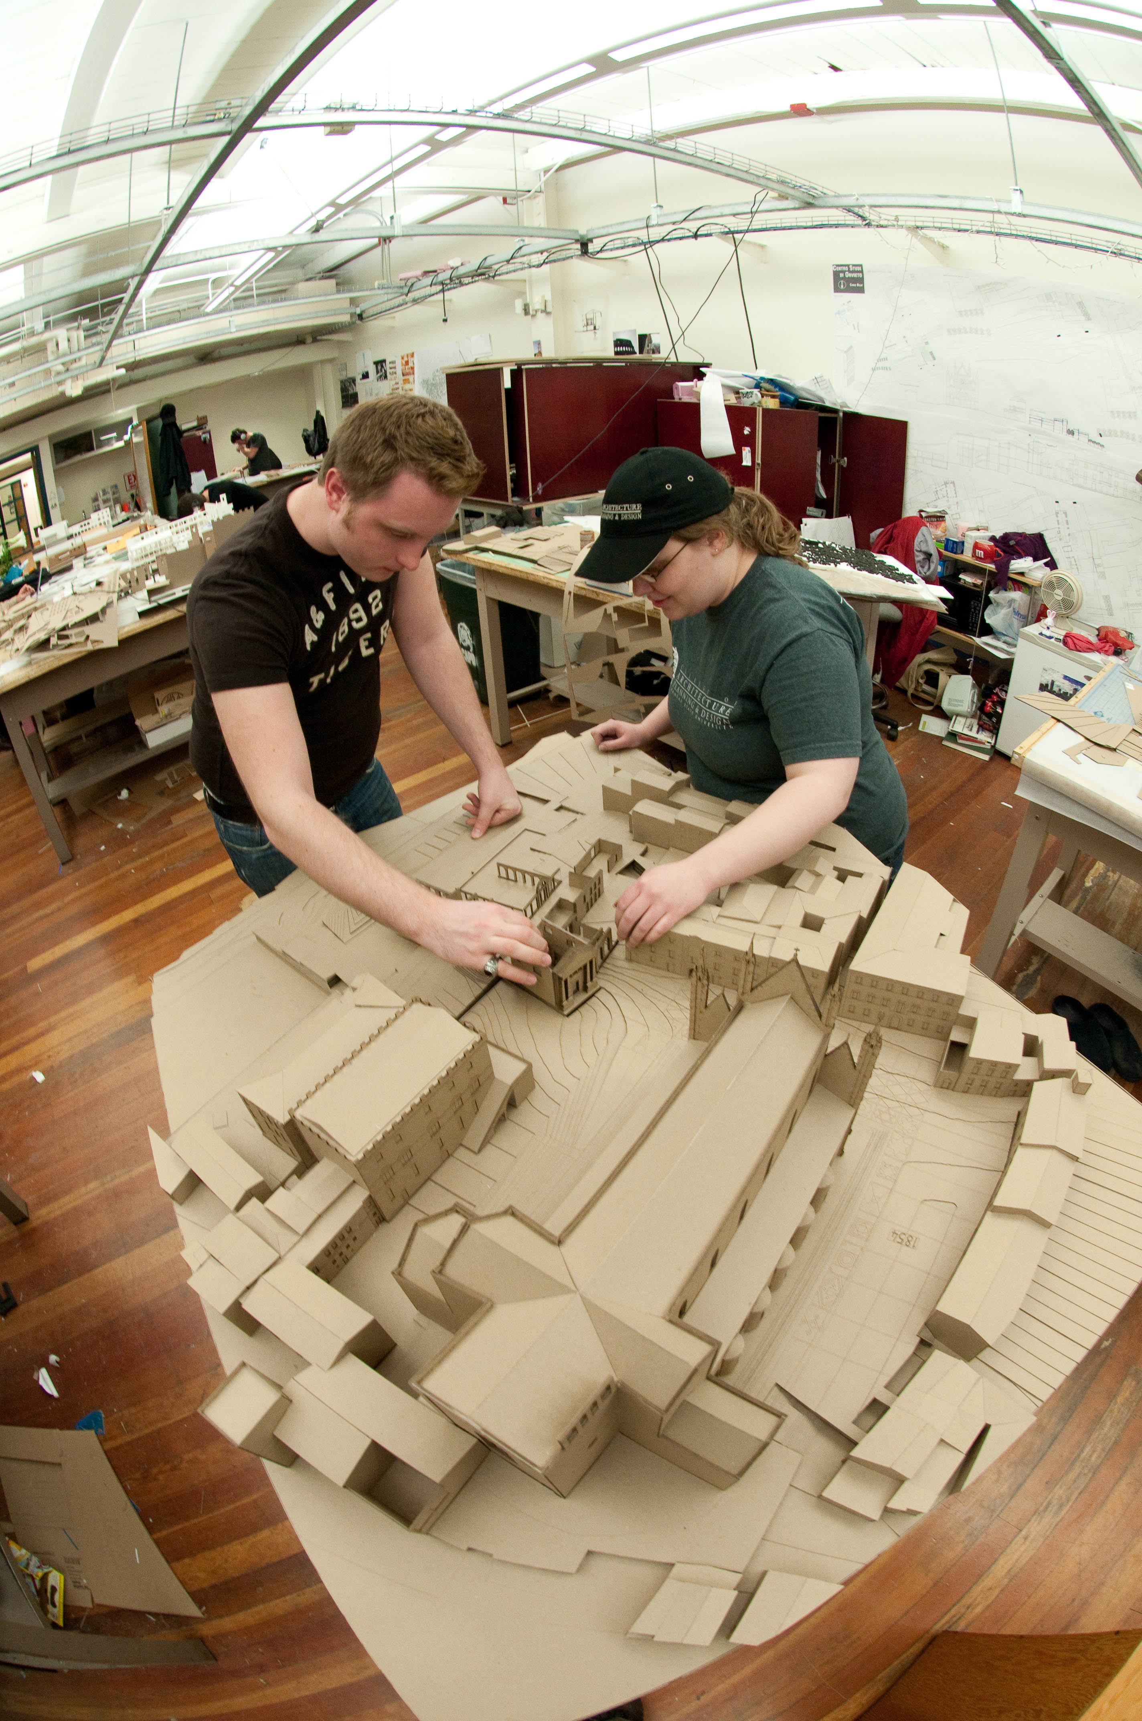
Institutional Context
First fully operational land-grant
Located in Manhattan, KS
Public research university
4 Campuses, 9 Colleges
Over 200 undergraduate & 100 graduate programs
24,000+ students
Institutional Assessment Office: 2 FTE and 2 undergraduate students

Slide 3
Institutional Context: Outcomes Alignment
Outcome
Outcome
Outcome
Outcome
Outcome
Outcome
Outcome
Outcome
Outcome
Degree Completion Achievement:
Exceeds Program Expectation (Advanced)
Meets Program Expectations (Proficient)
Meets Minimum Program Expectations (Developing)
Does Not Meet Program Expectations (Unacceptable)
Program Outcome #1
Program Outcome #2
Program Outcome #3

Slide 4
Institutional Context: Reporting and Feedback Process

Slide 5
Project Goals
Automate data collection and visualization
User-specified breakdowns
Customized reports for each program
All assessment data available in one place
Use tools already available
Workload
Impact

Slide 6
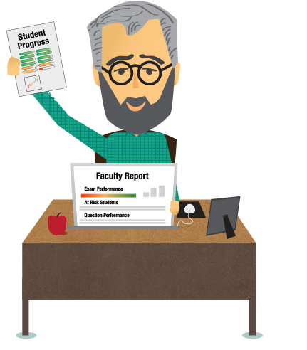
LMS Setup and Overall Workflow
Set Up Program Outcomes
Program Reporting
SLO 1
SLO 2
SLO 3
Program Level
Course Level
Import & Align Outcomes
Assess Outcomes
SLO 1
SLO 2
SLO 3

Slide 7
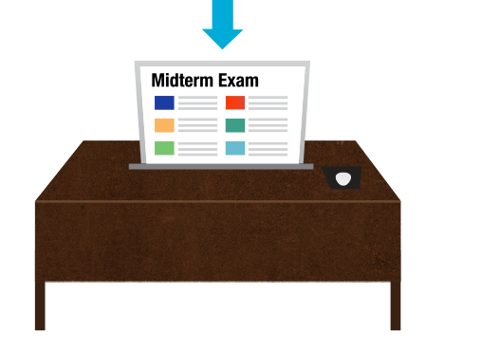
Faculty
Faculty Workflow
Student

Slide 8
Demo
Find more info at www.ksu.edu/assessment

Slide 9
Institutional Role
Data at the student-level enables enhanced analysis. Does not have to be from the LMS.
Demographics
Gender
Transfer
Online
Etc.
Survey results
Other
Retention
Graduation
GPA
Etc.

Slide 10
Combining Assessment Data
Survey Results
Embedded Results
Feedback Documents
Combined, interactive dashboards and reports
Data Warehouse
Demographics
Other outcomes

Slide 11
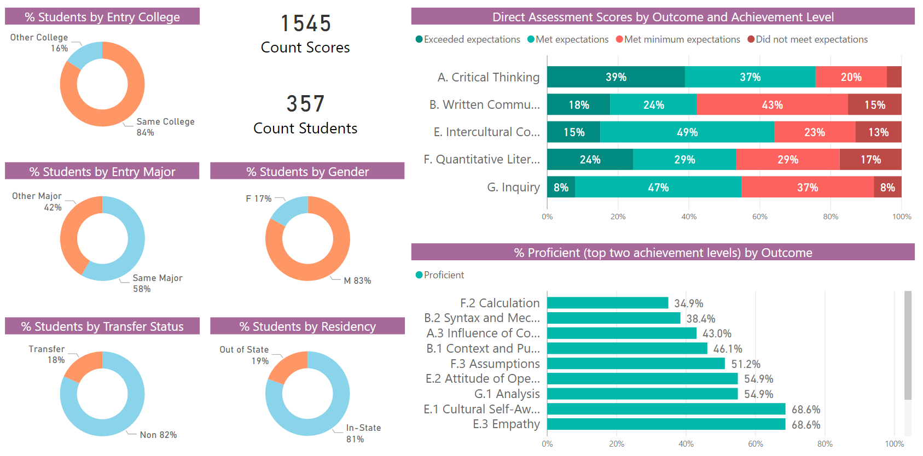
Direct Assessment Sample Report

Slide 12
Demo
Find more info at www.ksu.edu/assessment

Slide 13
Lessons Learned
Modern visualization tools can work with a variety of data sources, allowing more program processes to be integrated
Assessment data via spreadsheets, form/survey reporting, etc.
Adapt tools to meet programmatic needs
Presenting examples helps programs recognize value
This process may not be appropriate for all programs

Slide 14
Questions?
Find more at: www.ksu.edu/assessment
Frederick Burrack – Director fburrack@ksu.edu
Chris Urban – Assistant Director chrisu@ksu.edu

